Slide 1
Module 3: Machine Learning Fundamentals
Philippe Nivlet

Slide 2
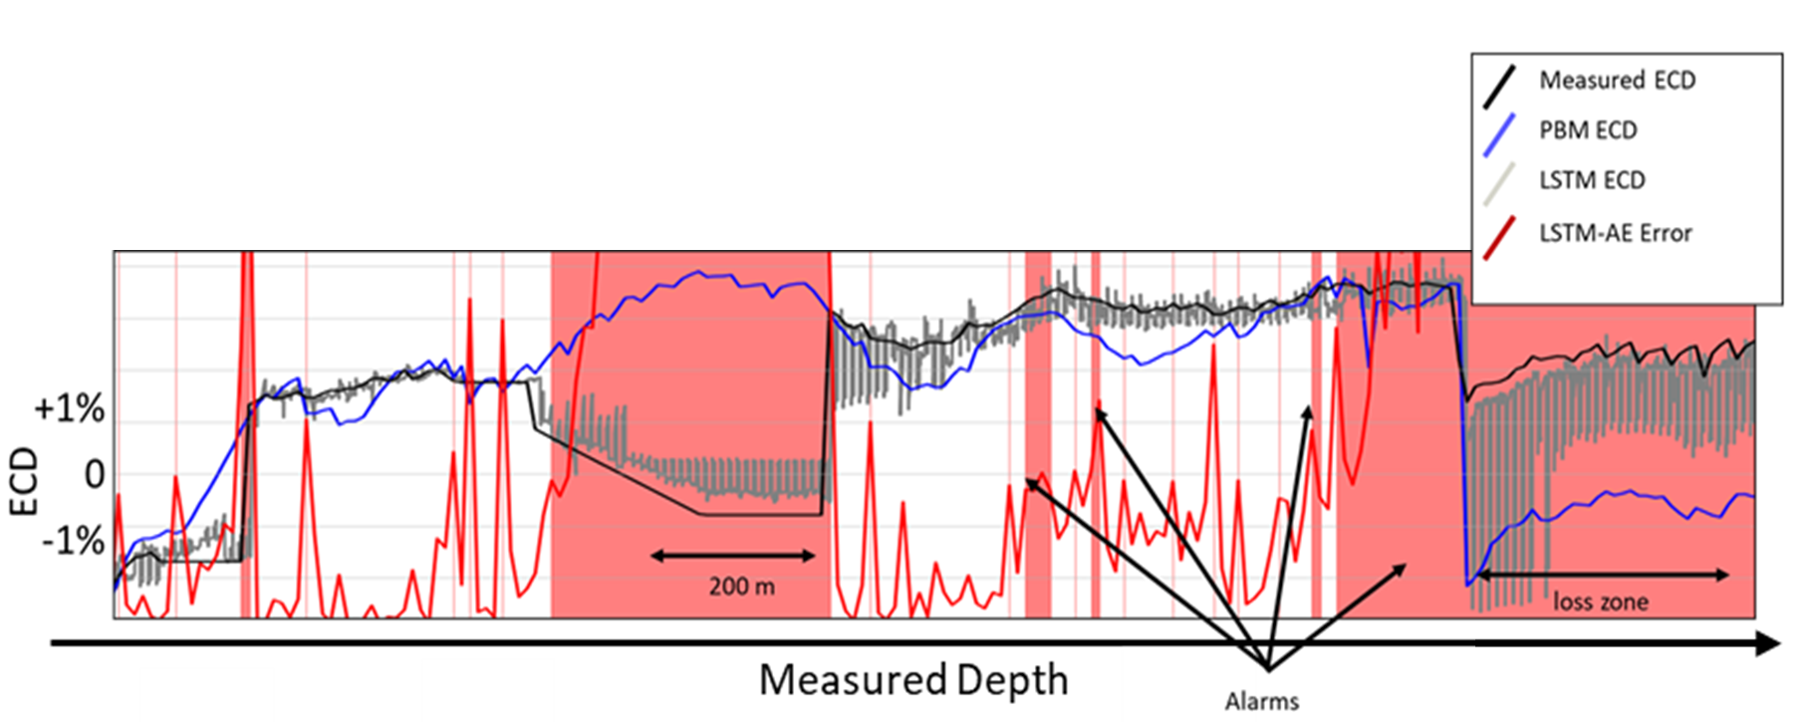
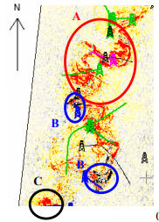
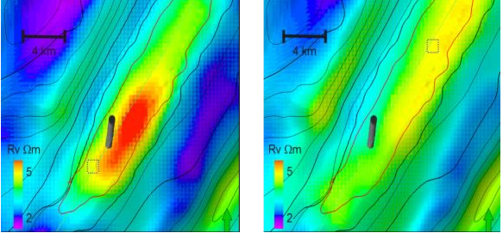
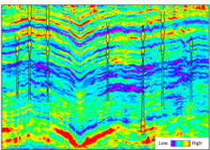
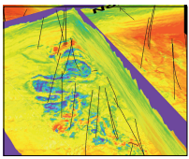
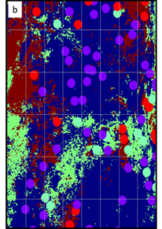
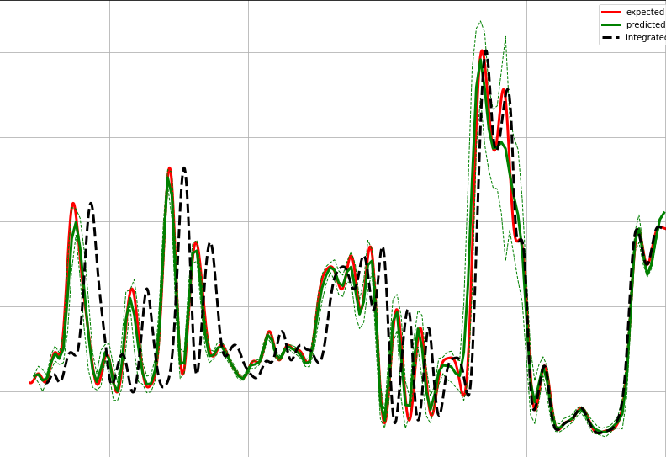
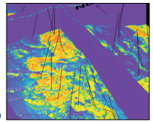
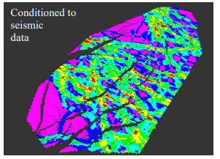
MACHINE LEARNING
Anomaly detection / hybrid modelling with drilling data
EM/Seismic data joint interpretation
Robust deep learning inversion
Model based Pre-stack inversion
4D Pre-stack inversion
Quantitative interpretation
Geological model integration
Integration seismic/drilling
Deep learning well tie
2000
2010
2020

Slide 3
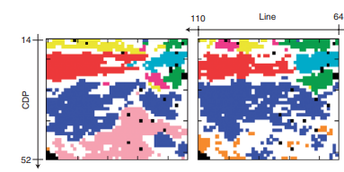
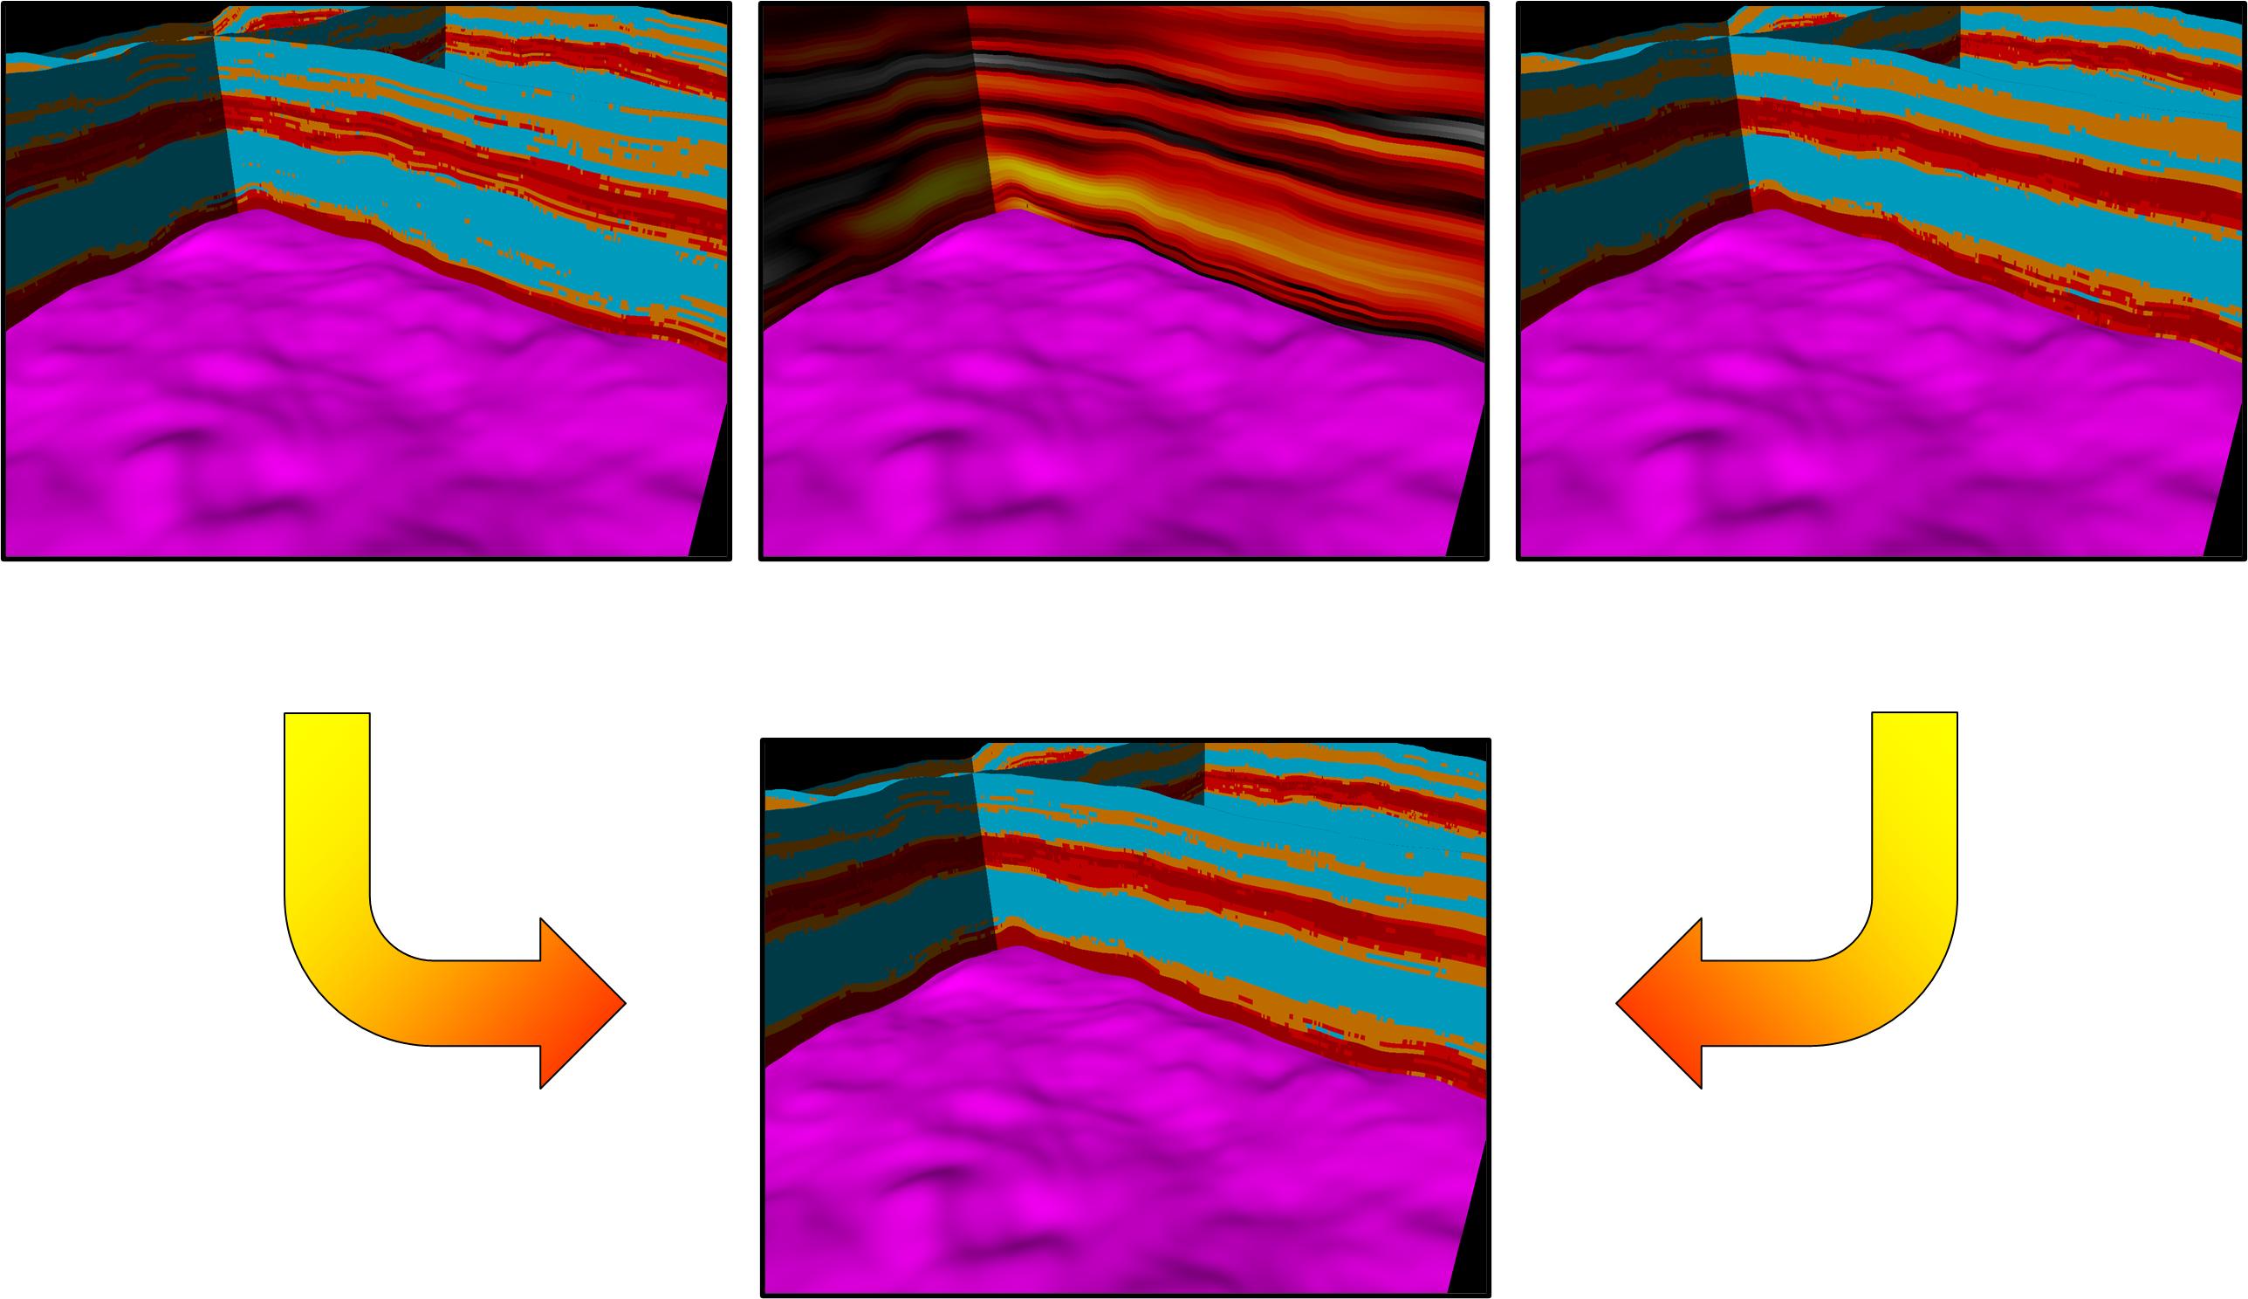
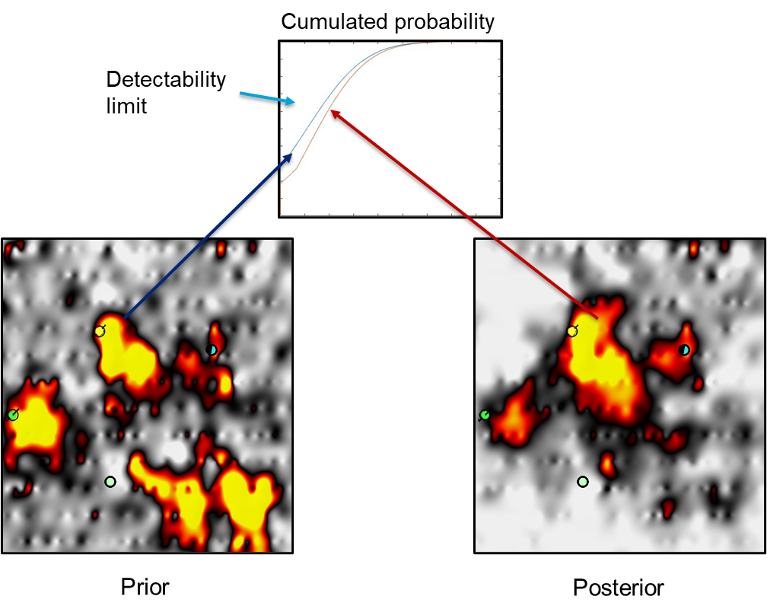
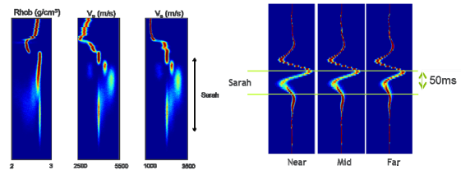
UNCERTAINTY CHARACTERIZATION
Interval discriminant analysis
Seismic Confidence cube for geological model integration
Integration Seismic / Reservoir
Geostatistical pseudo-wells
2000
2010
2020

Slide 4
Day 1: Fundamentals and Logistic regression
Introduction

Slide 5

Introduction

Slide 6
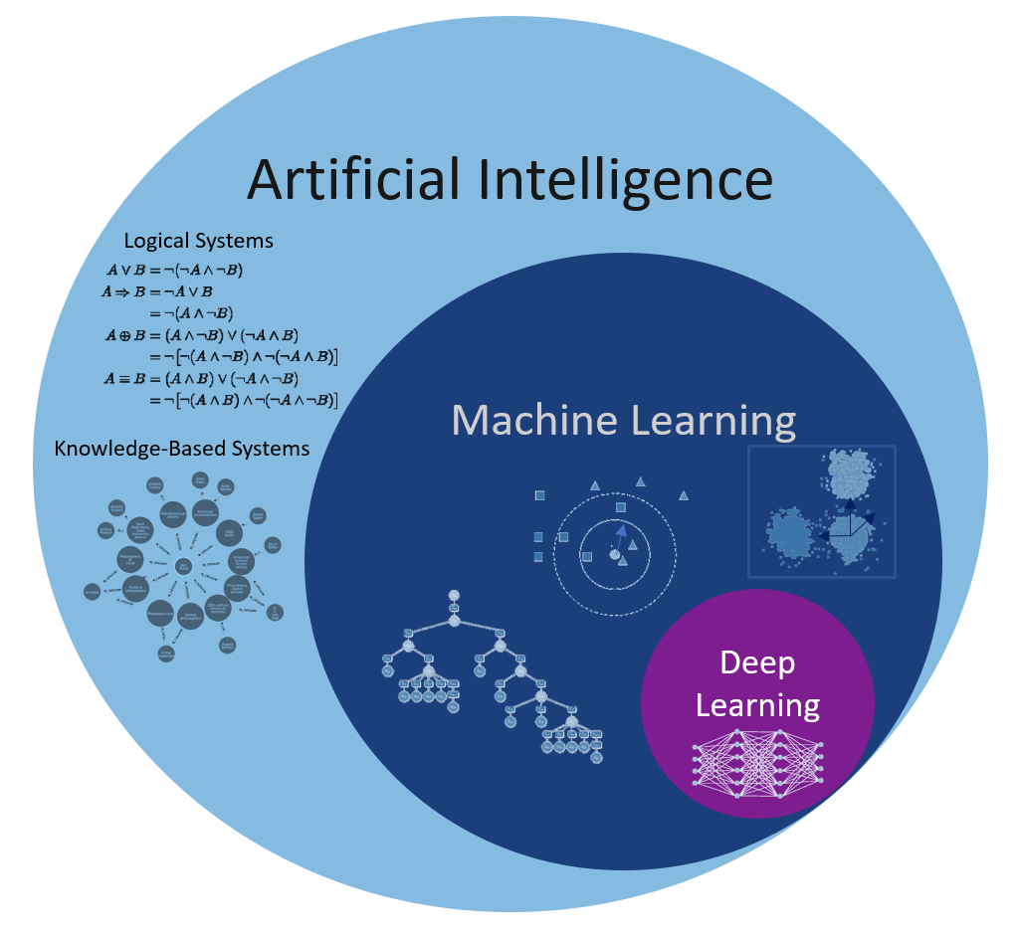

What is Machine Learning?
Foundations: 18th century (Bayes theorem, …)
1940-50’s: First neuro-machines
Samuel Adams (1959): first checkers playing self-learning algorithm
Definition: Field of study that gives computers the ability to learn without being explicitly programmed

Slide 7
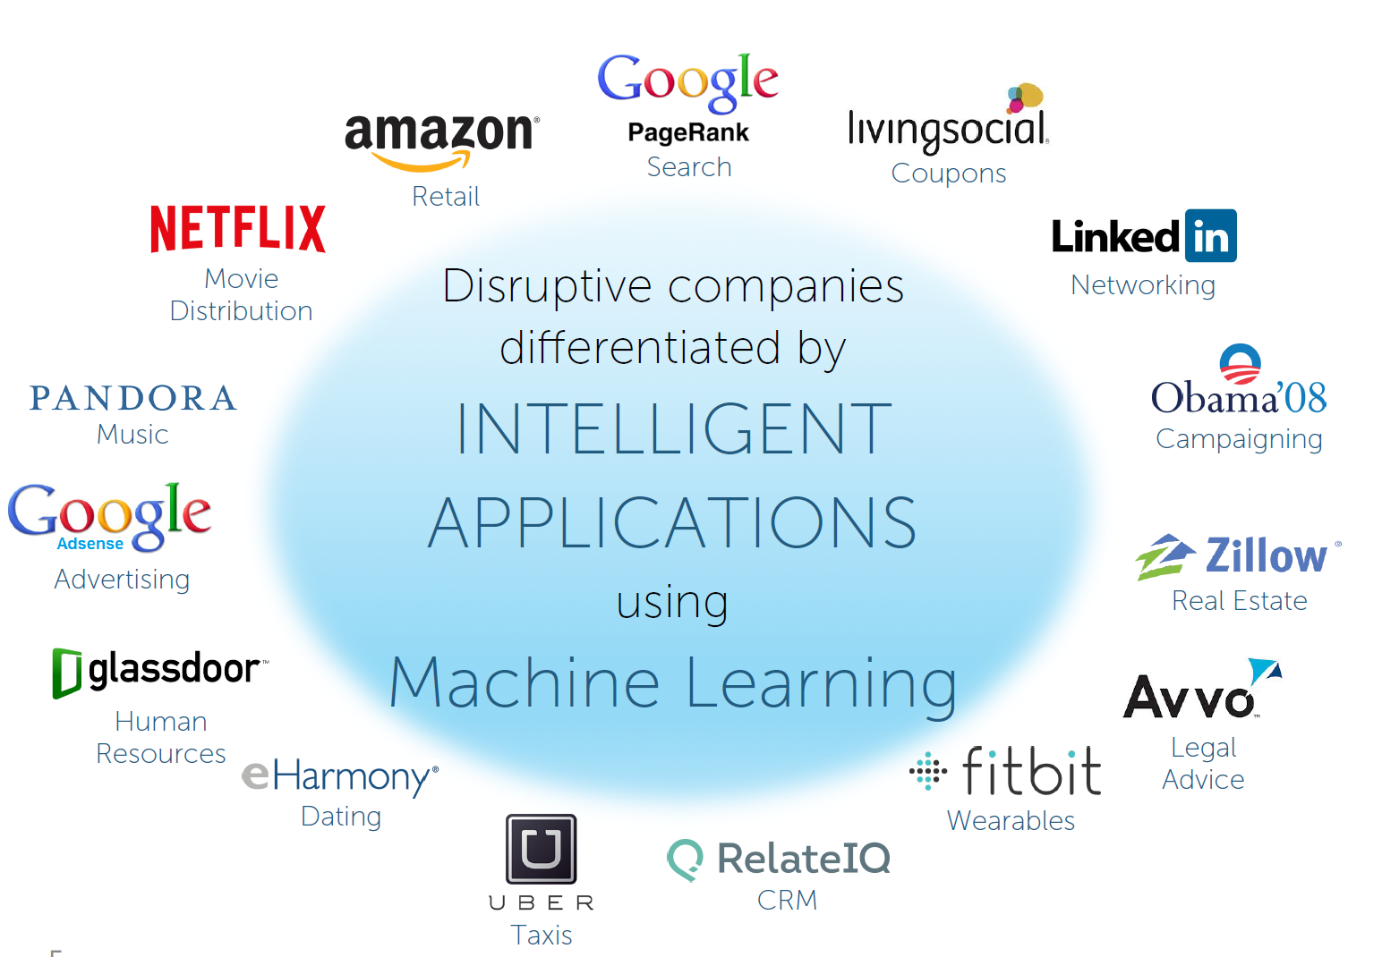
Machine Learning

Slide 8
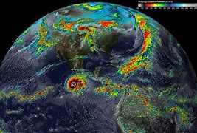

Classical modelling
Model
Input
output
T | P | x | y
T(+1 h) | Should I water my garden?
weather forecast model
Data point, row, individual, example …
Feature, attribute, column…
Decision tree (deterministic)…

Slide 9
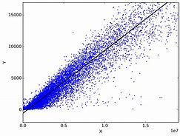
Mochine learning modelling (House market example)
Input
output
size | # room | location | age
65 | 2 | sentrum | 1980
54 | 1 | Ranheim | 2000
Model?
Asking Price? | Price overestimated?
5 | n
6 | y
Ingrid
Frode
Data point, row, individual, example …
Feature, attribute, column…

Slide 10
Supervised / Unsupervised Machine Learning
Supervised learning:
Unsupervised learning
y
?
Data compaction
(extract important information)
?
Regression:
(price vs #room)
X
X
X₂
X₂
?
Clustering
Similar houses?
y = class
?
Classification
Bid Above / under
X₁
X₁

Slide 11
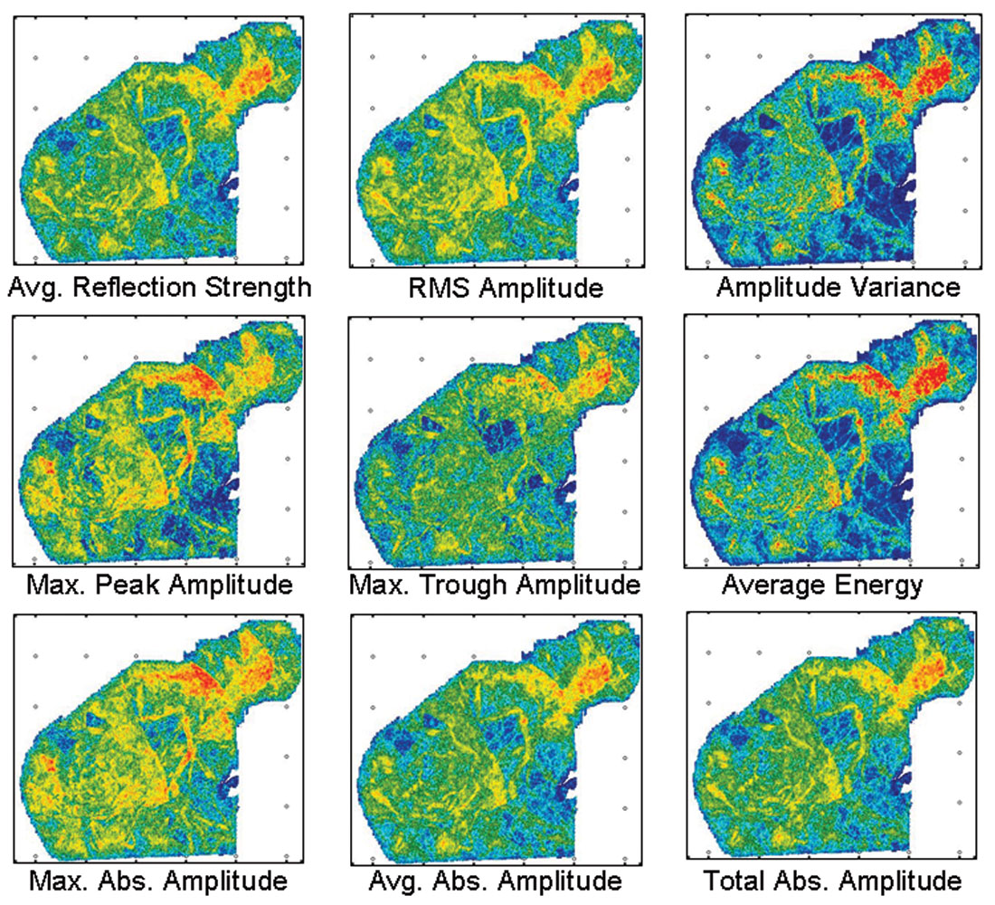
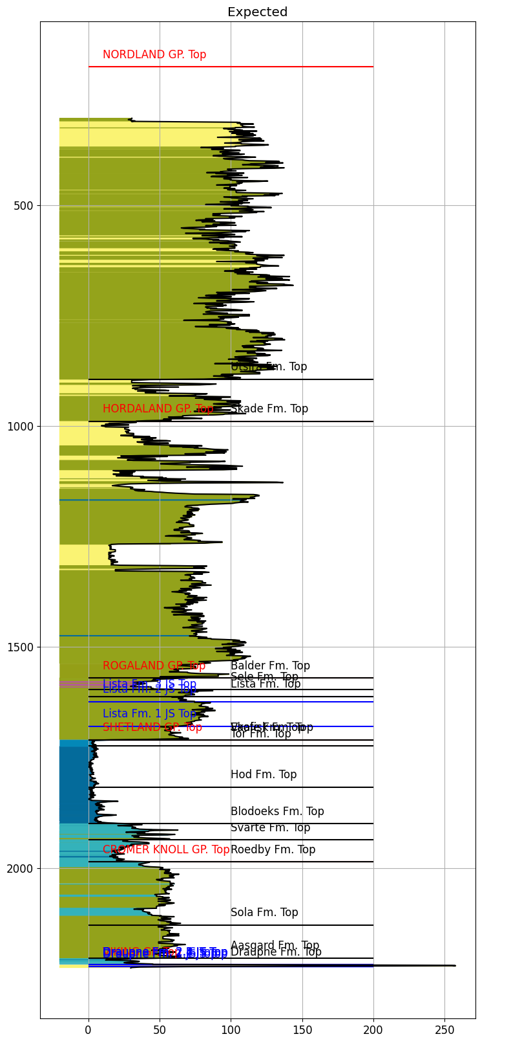
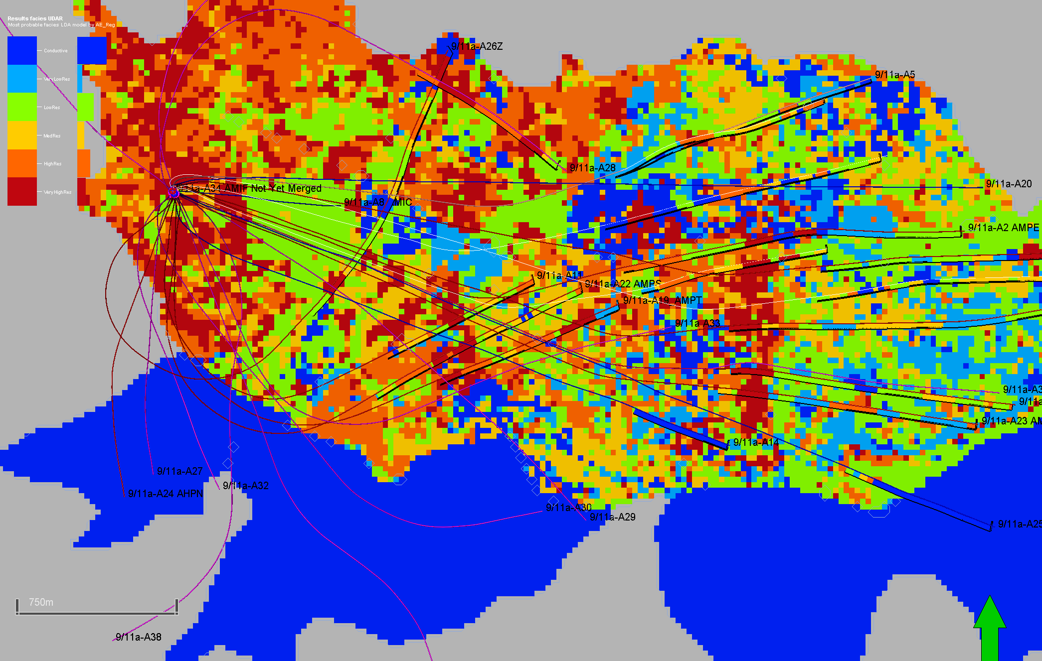
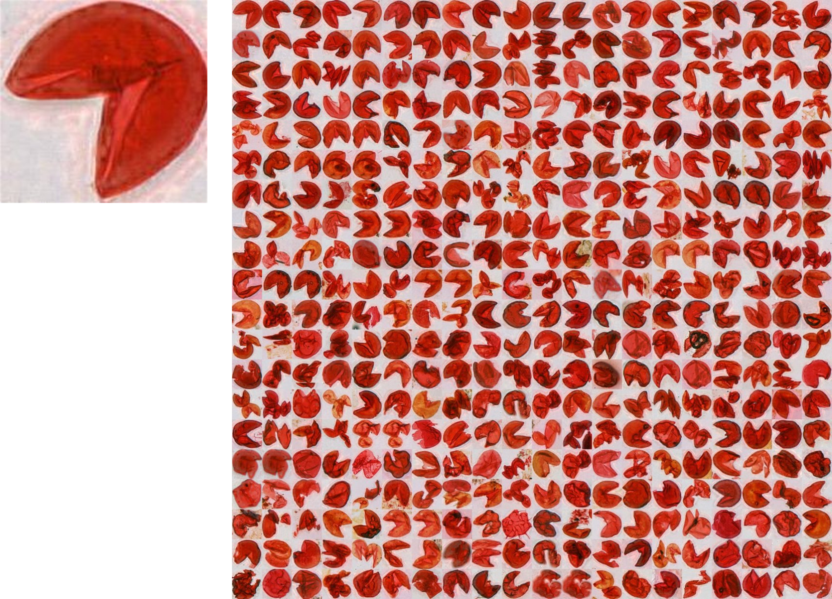
Common applications of classification (geosciences)
REAL
Seismic facies maps (Reservoir characterization / monitoring)
Drilling time series + Logging While Drilling
Lithology in Real Time
Seismic attribute maps
Drilling risk prediction
SCAMPI
How resistive is the reservoir?

Slide 12
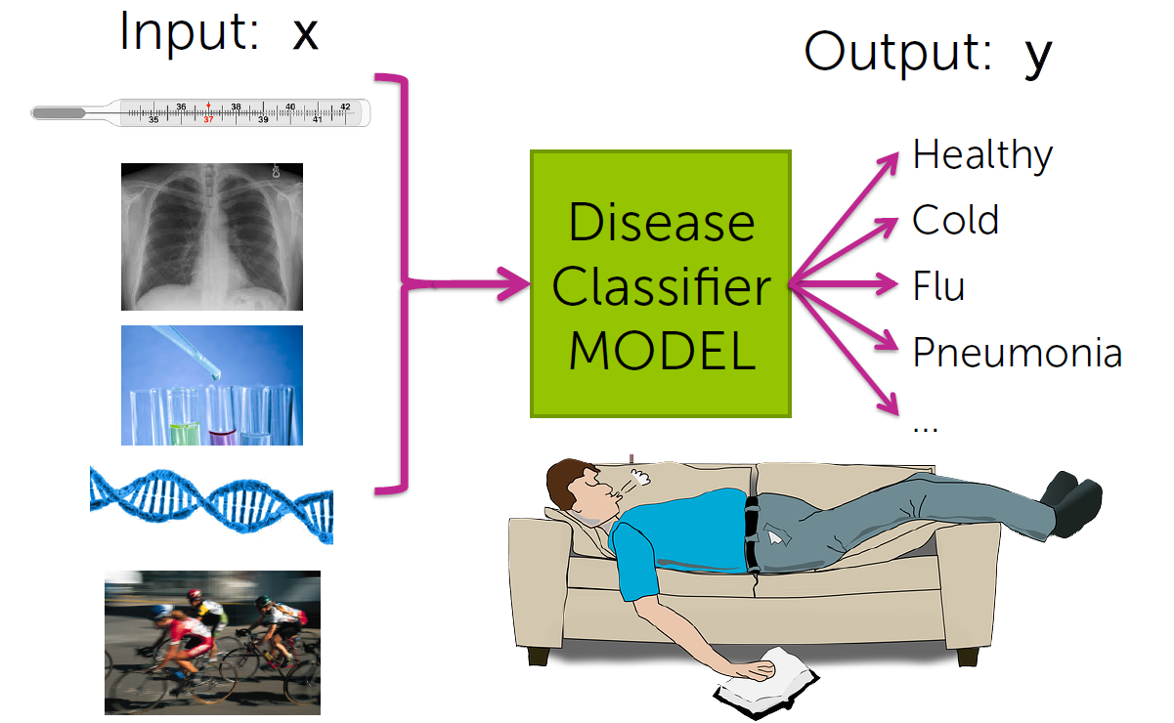
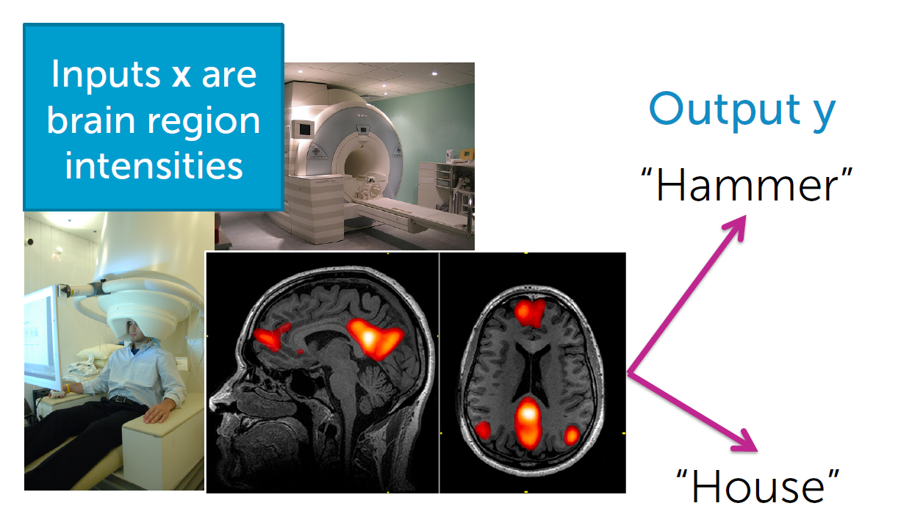
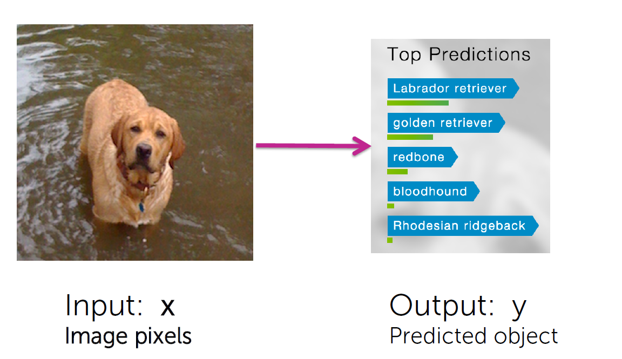

Common applications of classification

Slide 13
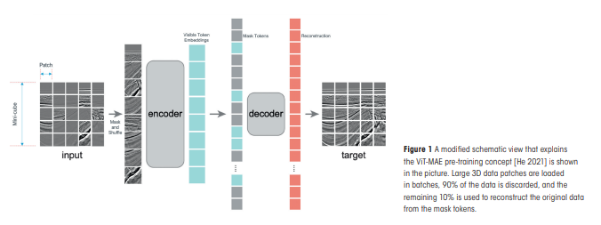
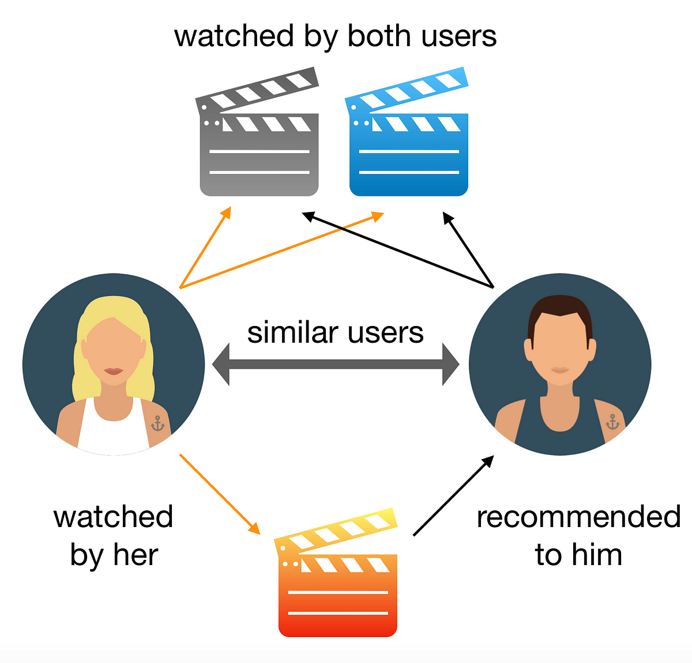

Some applications of unsupervised ML
Foundation models
Recommender systems
Networking

Slide 14
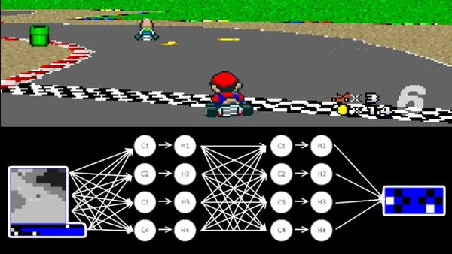


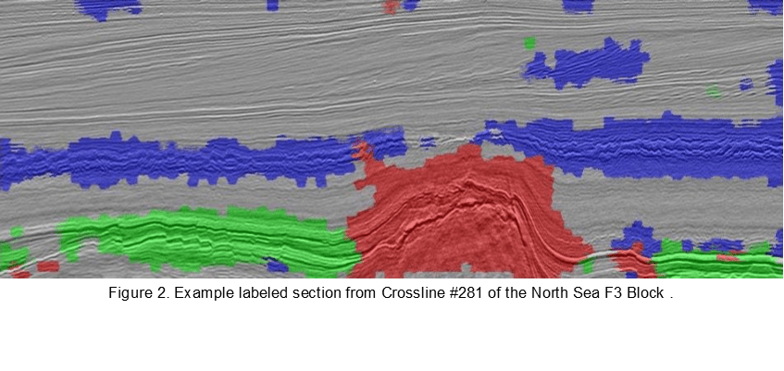
Other types of machine learning
Semi-supervised learning
Weakly supervised learning
Reinforcement learning
X₂
y = class
X₁

Slide 15
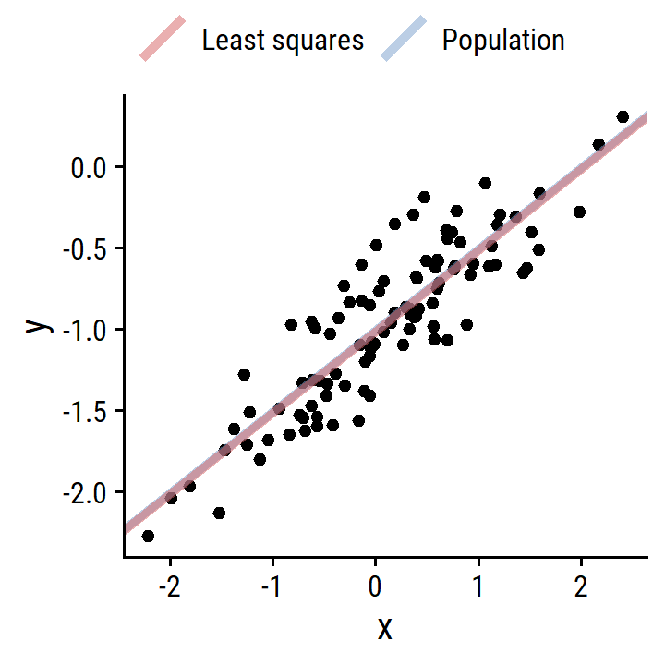
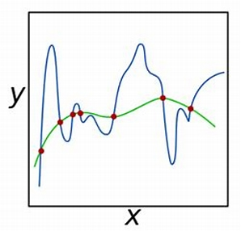
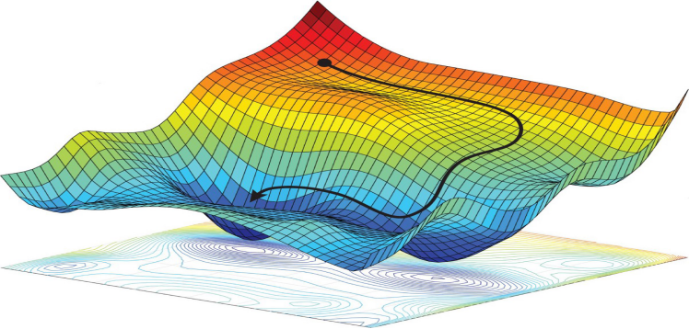
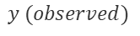
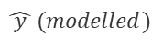
The pilars of Machine Learning algorithm – example house selling
size | # room | location | age
65 | 2 | sentrum | 1980
54 | 1 | Ranheim | 2000
Ingrid
Frode
Model?
1: algorithm
$$\hat{ y } (modelled)$$
4: Regularization
2: Evaluation
price
5
6
8
4
$$y (observed)$$
3: Optimization

Slide 16
The pilars of Machine Learning algorithm – example house selling
size | # room | location | age
65 | 2 | sentrum | 1980
54 | 1 | Ranheim | 2000
Ingrid
Frode
Model?
1: algorithm
$$\hat{ y } (modelled)$$
4: Regularization
2: Evaluation
price
5
6
8
4
Tom Mitchell (1998) Well-posed Learning Problem: A computer program is said to learn from experience E with respect to some task T and some performance measure P, if its performance on T, as measured by P, improves with experience E.
$$y (observed)$$
3: Optimization

Slide 17
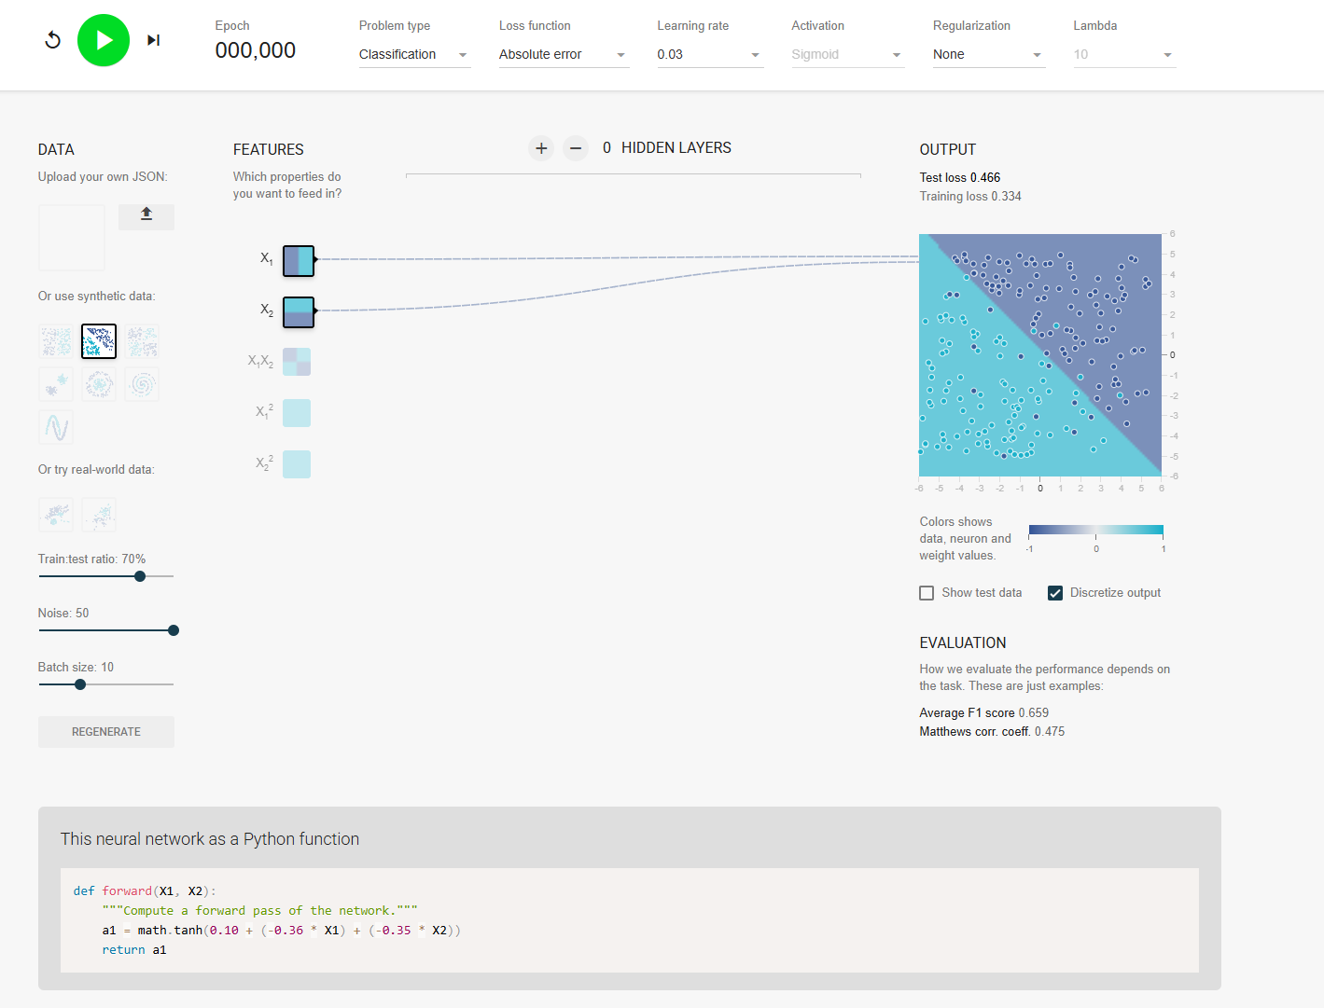
Hands-on: Classification intuition
Use: A Machine Learning Playground
Settings: red arrows
Identify the different ML components
Vary the initial guess (cyan arrow) and note the changes (losses)
Step wise training: green arrow
Observations?
change data (half moons/spirals, circular):
Observations? Can you change model parameters to improve the results?

Slide 18

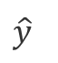
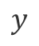
Roadmap for this course
Model?
X
$$\hat{y}$$
1: algorithm
2: evaluation
4: Regularization
Details on one algorithm (logistic regression) – Day 1+2
Project - Day 2
$$y$$
3: optimization

Slide 19
Detailed Roadmap
Day 1 :
Introduction Machine Learning
Before even starting the analysis
Logistic regression
Algorithm intuition
Log likelihood
Gradient descent
Model evaluation metric
Day 2:
Feature Engineering & Preprocessing
Regularization
Hyper-parameter tuning
Additional topics in these hands-out:
Some alternate algorithms:
Support Vector Machines
Discriminant analysis
K-Nearest-Neighbor
Decision trees
Random forests
Boosting principle
A case study: Real-Time analysis of lithology while drilling
Project

Slide 20
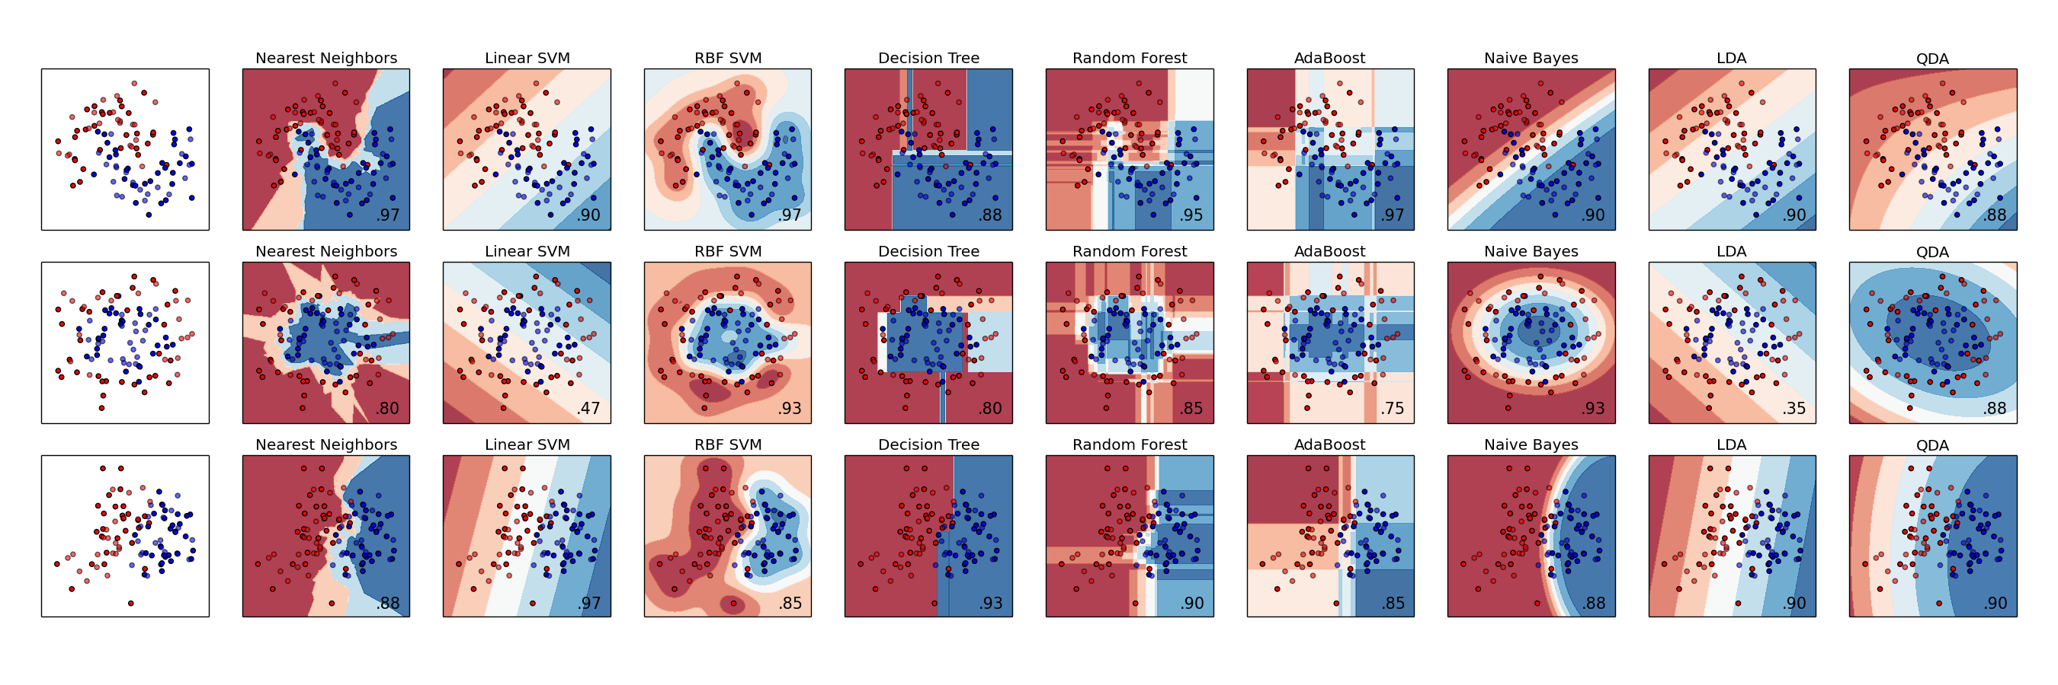
High level overview of classification algorithms (Scikit-learn.org)
Support Vectors
decision trees based
probability based
Ensemble based

Slide 21
Day 1: Fundamentals and Logistic regression
Before even starting the analysis

Slide 22
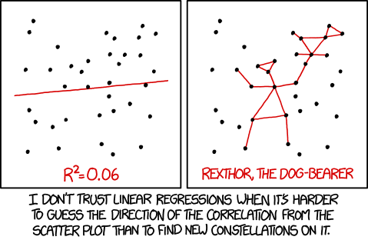
Data analysis and visualization

Slide 23
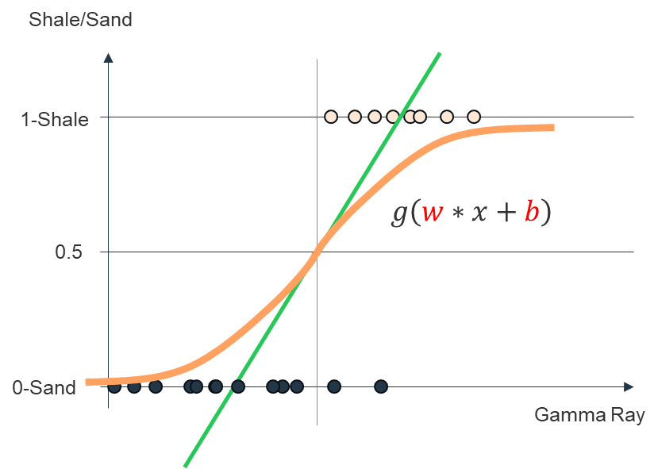

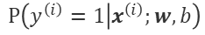
The pilars of Machine Learning algorithm training
x
Model?
1: algorithm
$$P\left(y^{\left(i\right)}=1 | x^{\left(i\right)};w,b\right)$$
4: Regularization
2: Evaluation: Log likelihood
3: Optimization
$$class 0/1$$

Slide 24
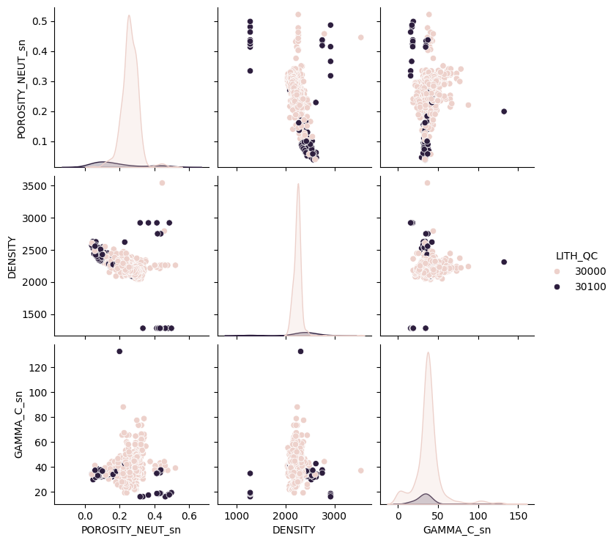
Some real problems…
import seaborn as sns
import pandas as pd
pd.set_option(‘display_rows’,None)
# data slicing
sdst = data.query('LITH_QC<=35000 & wellbore=="162D42«’ )
# data statistics
sdst.describe()
data.groupby(by=‘wellbore’).describe().T
# Example display
sns.pairplot(data=sdst[['POROSITY_NEUT_sn','DENSITY','GAMMA_C_sn','LITH_QC']],hue='LITH_QC')

Slide 25
Coding lab 1: Exploratory data analysis (reminder module 2)
The problem will be to interpret multiple log measurements sampled along well trajectories in terms of lithology
Explore the data set:
Main statistical characteristics?
Distributions per lithology?
Cross-plots?
Discuss:
Is the problem easy? are some lithologies easier to predict than others?

Slide 26
Day 1: Fundamentals and Logistic regression
Logistic regression – the basics

Slide 27

Logistic regression
Intuition
Interpretation
Decision boundary

Slide 28
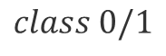
The pilars of Machine Learning algorithm training
x
Model?
1: algorithm
$$P\left(y^{\left(i\right)}=1 | x^{\left(i\right)};w,b\right)$$
4: Regularization
2: Evaluation: Log likelihood
3: Optimization
$$class 0/1$$

Slide 29
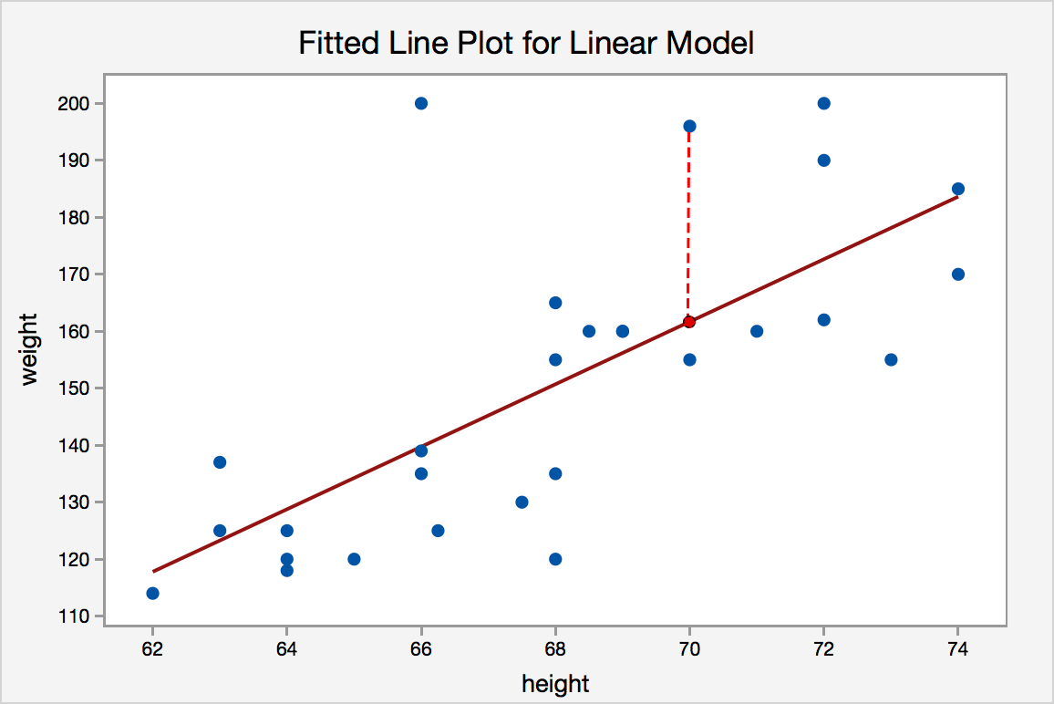
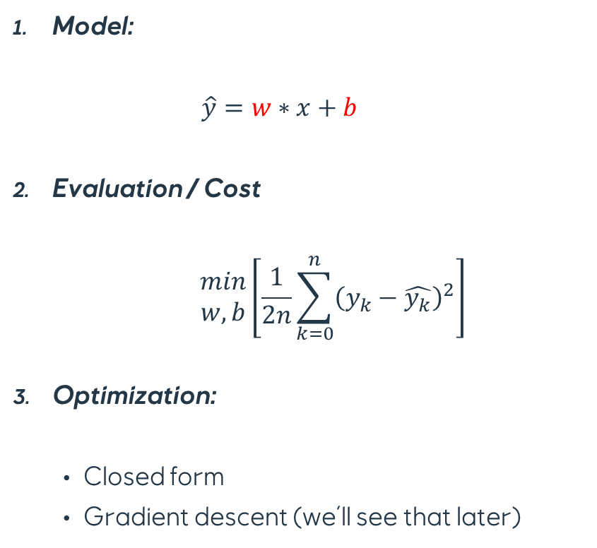
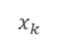
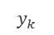
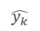
Linear regression reminder
Model:
$$\hat{y}=w∗x+b$$
Evaluation / Cost
$$\begin{matrix}min \\ w,b\end{matrix}\left[\frac{1}{2n}\sum_{k=0}^{n}{{\left(y_{k}−\hat{y_{k}}\right)}^{2}}\right]$$
Optimization:
Closed form
Gradient descent (we’ll see that later)
$$y_{k}$$
sum of losses @ y_{k}
$$\hat{y_{k}}$$
w
1
$$x_{k}$$
x

Slide 30
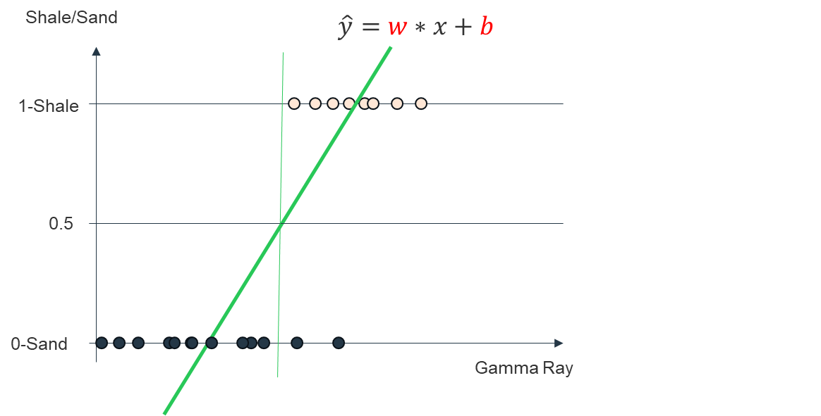
Lab 1: Linear regression in classification tasks
In the widget we have fitted a regression line to the sample data. In order to classify them to one of the two classes, we have defined a threshold at y=0.5
Do we achieve a reasonable classification?
We can add points to the red class by clicking close to y=1; and to the blue class by clicking close to y=0
Now add points at x=10. What do you see?

Slide 31
Why does linear regression fails on classification tasks?
Problem 1: labels ‘y’ are not continuous
Solution: assign (arbitrary) code to labels
Problem 2: Errors on predicted values are supposed to be normally distributed and have constant variance
No Solution
Problem 3: Regression model gives values outside [0,1]
Solution: discretize predicted output
Shale/Sand
$$\hat{y}=w∗x+b$$
1-Shale
0.5
0-Sand
Gamma Ray

Slide 32
Why does linear regression fails on classification tasks
Problem 4: Model sensitive to imbalanced data or outliers
Solution: do not use linear regression !
Shale/Sand
1-Shale
0.5
0-Sand
Gamma Ray

Slide 33
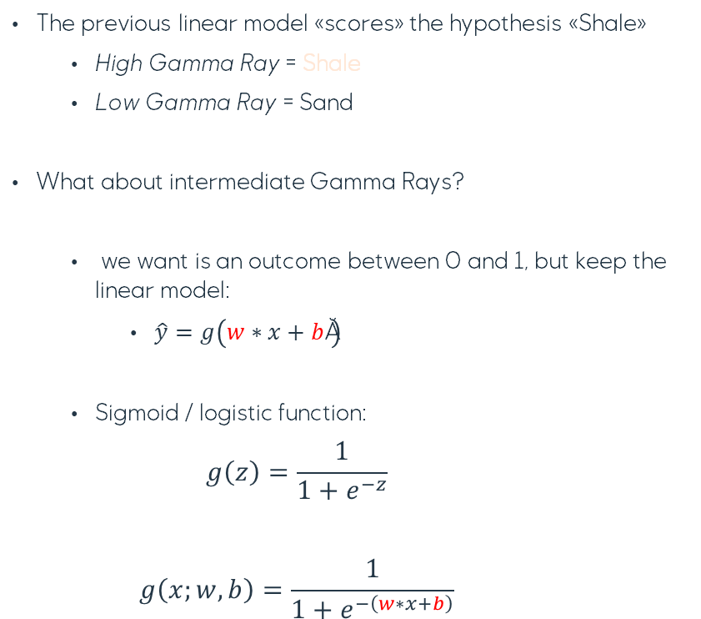

Introduction to logistic regression
The previous linear model «scores» the hypothesis «Shale»
High Gamma Ray = Shale
Low Gamma Ray = Sand
What about intermediate Gamma Rays?
we want is an outcome between 0 and 1, but keep the linear model:
$\hat{y}=g\left(w∗x+b \right)$
Sigmoid / logistic function:
$$g\left(z\right)=\frac{1}{1+e^{−z}}$$
$$g\left(x;w,b\right)=\frac{1}{1+e^{−\left(w∗x+b\right)}}$$
$$\hat{y}=w∗x+b$$
Shale/Sand
1-Shale
$$g\left(w∗x+b\right)$$
0.5
0-Sand
Gamma Ray

Slide 34
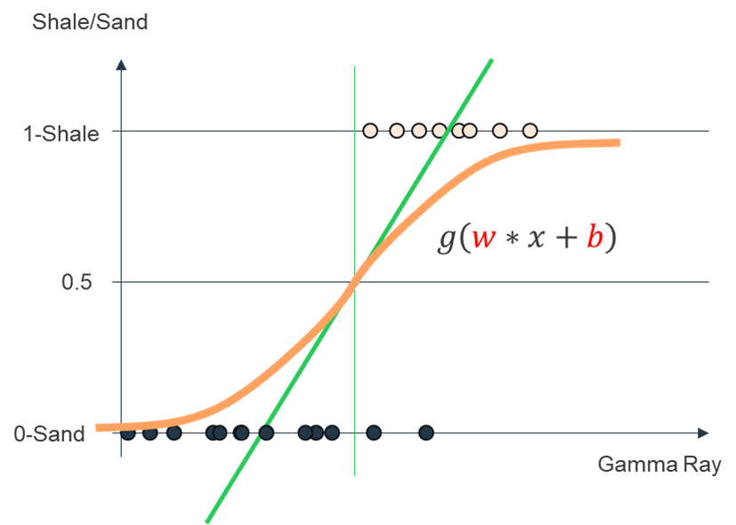
Lab 2: Logistic regression in classification tasks
In the widget, we have done the same as lab 1, but have added a graph with an automatic fit of the logistic regression based on the previous sigmoid function
Do we achieve a reasonable classification?
We can add points to the red class by clicking close to y=1; and to the blue class by clicking close to y=0
Now add points at x=10. Do we still have the same problems as in lab 1?

Slide 35


Introduction to logistic regression: more than one input feature?
$$\hat{y}=w_{1}∗x_{1}+w_{2}∗x_{2}+b= θ^{T}x$$
$$g\left(x;θ \right)=\frac{1}{1+e^{−θ^{T}x}}$$
Vp
$$g\left(θ^{T}x\right)$$
Gamma Ray

Slide 36

Lab 3: Sigmoid function
In the provided notebook, run the cells until you have the widget.
The sliders control the parameters w and b of the function. What do they control?
Try to find parameters that discriminate correctly sands from shales with GR
Repeat the exercise with two features of your choice (2nd part of the notebook)

Slide 37

Interpretation
Properties of g:
$\lim_{x→−∞}{g\left(x;θ\right)}=0$
$\lim_{x→+∞}{g\left(x;θ\right)}=1$
$g\left(x;θ\right)∈\left[0;1\right]$
g(x;θ)=0.7 can be interpreted as 70% of chance of being shale …and then 30% of chance of being sand
So $g\left(x;θ\right)=P\left(y=1 | x;θ\right)$
NB: $P\left(y=0 | x;θ\right)=1−P\left(y=1 | x;θ\right)$
NB: $θ^{T}x$ is interpreted as the logarithm of odds
P(sand | GR)=0.75
P(shale | GR)=0.25
New point

Slide 38





Decision boundaries
1 feature (eg GR)
More than 1 feature (eg GR + Porosity)
$$θ^{T}x>0$$
$$θ^{T}x<0$$
$$w∗x+b<0$$
$$w∗x+b>0$$

Slide 39
Binary vs multiclass classification
?
one-vs-one estimator
One-vs-rest estimator
O(n_class²) classifiers
Score red class: average score for all classifiers with red class
O(n_class) classifier
Class(x) = Max score

Slide 40
Day 1: Fundamentals and Logistic regression
Log likelihood

Slide 41

Log-likelihood
Cost function
why MSE does not work here

Slide 42
The pilars of Machine Learning algorithm training
x
Model?
1: algorithm
$$P\left(y^{\left(i\right)}=1 | x^{\left(i\right)};w,b\right)$$
4: Regularization
2: Evaluation: Log likelihood
3: Optimization
$$class 0/1$$

Slide 43

Choosing the model parameters = evaluating model with maximum likelihood…
Training set:
How to choose θ «automatically»?

Slide 44


Why does MSE Cost function does not work?
Mean Squared Error MSE cost function in regression
$L\left(x^{\left(i\right)},y^{\left(i\right)};θ\right)=\frac{1}{2n}\sum_{i=0}^{n}{{\left(y^{\left(i\right)}−θ^{T}x^{\left(i\right)}\right)}^{2}}$
MSE cost function in Logistic regression
$L\left(x^{\left(i\right)},y^{\left(i\right)};θ\right)=\frac{1}{2n}\sum_{i=0}^{n}{\left\{\begin{aligned}{\left(1−\frac{1}{1+e^{−{ θ}^{T}x^{\left(i\right)}}}\right)}^{2} ify^{\left(i\right)}=1 \\ {\left(0−\frac{1}{1+e^{−{ θ}^{T}x^{\left(i\right)}}}\right)}^{2}ify^{\left(i\right)}=0\end{aligned}\right. }$
L
L
w_{k}, b
w_{k}, b
Non Convex, non smooth ➔ Difficult to optimize
Does not penalize enough misclassifications
Convex, smooth ➔ Easy to optimize

Slide 45


Log lilelihood loss aka cross-entropy function
Likelihood function:
$l\left(x^{\left(i\right)},y^{\left(i\right)};θ\right)=\left\{\begin{aligned}P\left(y^{\left(i\right)}=1 | x^{\left(i\right)};θ\right) ify^{\left(i\right)}=1 \\ 1−P\left(y^{\left(i\right)}=1 | x^{\left(i\right)};θ\right) ify^{\left(i\right)}=0\end{aligned}\right.$
Training set likelihood (to be maximized):
$L\left(\left\{x^{\left(i\right)},y^{\left(i\right)}\right\};θ\right)=\prod_{i=1}^{n}{l\left(x^{\left(i\right)},y^{\left(i\right)};θ\right)}$
Neg. Log-likelihood loss (to be minimized):
$L\left(\left\{x^{\left(i\right)},y^{\left(i\right)}\right\};θ\right)=−\frac{1}{2n}\sum_{i=1}^{n}{log\left(l\left(x^{\left(i\right)},y^{\left(i\right)};θ\right)\right)}$
$L\left(\left\{x^{\left(i\right)},y^{\left(i\right)}\right\};θ\right)=−\frac{1}{2n}\sum_{i=1}^{n}{\left(y^{\left(i\right)}∗log\left(P\left(y^{\left(i\right)}=1 | x^{\left(i\right)};θ\right)\right)+\left(1−y^{\left(i\right)}\right)∗log\left(1−P\left(y^{\left(i\right)}=1 | x^{\left(i\right)};θ\right)\right)\right)}$
$$P\left(y_{i}=1 | x_{i};w,b\right)$$

Slide 46


Log likelihood

Slide 47

Lab 4: Log likelihood
In the provided notebook, we repeat the fitting exercise from lab 3, but the widget provides an evaluation of the log likelihood
Try to find parameters that best discriminate sands from shales with GR
Repeat the exercise with two features of your choice (2nd part of the notebook)

Slide 48
Day 1: Fundamentals and Logistic regression
Gradient descent

Slide 49

Gradient descent
Optimization
Convergence

Slide 50

The pilars of Machine Learning algorithm training
x
Model?
1: algorithm
$$P\left(y^{\left(i\right)}=1 | x^{\left(i\right)};θ\right)$$
4: Regularization
2: Evaluation: Log likelihood
3: Optimization
$$class 0/1$$

Slide 51






Optimization: gradient descent for logistic regression
$L\left(\left\{x^{\left(i\right)},y^{\left(i\right)}\right\};θ\right)=−\frac{1}{2n}\sum_{i=1}^{n}{\left(y^{\left(i\right)}∗log\left(P\left(y^{\left(i\right)}=1 | x^{\left(i\right)};θ\right)\right)+\left(1−y^{\left(i\right)}\right)∗log\left(1−P\left(y^{\left(i\right)}=1 | x^{\left(i\right)};θ\right)\right)\right)}$
L
Want $\min_{θ}L\left(\left\{x^{\left(i\right)},y^{\left(i\right)}\right\};θ\right)$
$$w_{j}$$
Repeat {
$$\frac{∂}{∂w_{j}}L\left(\left\{x^{\left(i\right)},y^{\left(i\right)}\right\};θ \right)$$
$$w_{j}≔w_{j}−α\frac{∂}{∂w_{j}}L\left(\left\{x^{\left(i\right)},y^{\left(i\right)}\right\};θ\right)$$
$${new w}_{j}$$
$$b≔b−α\frac{∂}{∂w_{j}}L\left(\left\{x^{\left(i\right)},y^{\left(i\right)}\right\};θ\right)$$
(simultaneously update all )

Slide 52


Optional homework
Derive the partial derivatives of the log-likelihood cost function
$\frac{∂}{∂w_{j}}L\left(\left\{x^{\left(i\right)},y^{\left(i\right)}\right\};θ\right)$= $\frac{1}{n}\sum_{i=1}^{n}{\left(\left(P\left(y^{\left(i\right)}=1 | x^{\left(i\right)};θ\right)−y^{\left(i\right)}\right)∗x_{j}^{\left(i\right)}\right)}$
$\frac{∂}{∂b}L\left(\left\{x^{\left(i\right)},y^{\left(i\right)}\right\};θ\right)$= $\frac{1}{n}\sum_{i=1}^{n}{\left(\left(P\left(y^{\left(i\right)}=1 | x^{\left(i\right)};θ\right)−y^{\left(i\right)}\right)\right)}$

Slide 53
Lab 5: Gradient descent on the Log likelihood cost function
Play with the widget: On the left, you have the MSE cost function while on the right the log likelihood.
Click on the left on any point in one of the graphic and check the convergence after gradient descent.
Try different starting points
Change the learning rate (slider): (repick an initial point) what happens with very small learning rate? with very high learning rate?

Slide 54
Convergence, learning rate
α is a key parameter
L
L
α = optimal
iterations
θ_{j}

Slide 55
Convergence, learning rate
α too small?
lot of iterations (time to converge)
More easily trapped in local minima
L
L
α = small
α = optimal
iterations
θ_{j}

Slide 56
Convergence, learning rate
α too big?
overshooting of minima
Algorithm may never converge (or even diverge)
L
α = big
L
α = small
α = optimal
iterations
θ_{j}

Slide 57

Convergence, learning rate
Unfortunately, picking step sizerequires a lot of trial-and-error L
Try a several values, exponentially spaced
Goal: plot learning curves to
find one α that is too small (smooth but moving too slowly)
find one α that is too large (oscillation or divergence)
Try values in between to find “best” α
Advanced tip: can also try step size that decreases with iterations, e.g.
for instance $α_{t}= \frac{α_{0}}{t}$
Try early stopping strategies (also because you may never find the absolute minimum)

Slide 58
Optional Coding lab: Implement logistic regression from scratch in Python
Complete the given code:
Cost function
Derivatives cost function
Gradient descent implementation
Hint: All the utility functions are in the previous labs.
Experiment different learning rates and pick up one that looks optimal
NB: Fortunately, Libraries like Scikit-Learn have already coded / optimized their own Logistic regression class - conveniently named LogisticRegression()

Slide 59
Day 1: Fundamentals and Logistic regression
Model evaluation metric

Slide 60
The pilars of Machine Learning algorithm training
x
Model?
1: algorithm
$$P\left(y^{\left(i\right)}=1 | x^{\left(i\right)};θ\right)$$
4: Regularization
2: Evaluation: Log likelihood
3: Optimization
$$class 0/1$$

Slide 61




Evaluating how model generalizes
Common strategies:
Train(/Validation)/Test split
Train/Validation/test data should be from the same distribution (random split)
Train/Validation/test should contain enough data (cross-validation / K-Fold cross-validation)
Train/Validation/test data should be independent (Spatial dependence)
10%
80%
10%

Slide 62

Evaluating how model generalizes
K-Fold cross-validation (useful especially when limited amount of data):

Slide 63
Code: Validation \ Cross-validation in Scikit-Learn
sklearn.model_selection.train_test_split(*arrays, test_size=None, train_size=None, random_state=None, shuffle=True, stratify=None)
Docs:
train_test_split — scikit-learn 1.6.1 documentation
sklearn.model_selection.cross_val_score(estimator, X, y=None, *, groups=None, scoring=None, cv=None, n_jobs=None, verbose=0, params=None, pre_dispatch='2*n_jobs', error_score=nan)
Docs:
cross_val_score — scikit-learn 1.6.1 documentation
>>> import matplotlib.pyplot as plt
>>> from sklearn.datasets import make_classification
>>> from sklearn.model_selection import cross_val_score
>>> from sklearn.linear_model import LogisticRegression
>>> X, y = make_classification(random_state=0)
>>> clf = LogisticRegression()
>>> clf.fit(X_train, y_train)
>>> print(cross_val_score(clf, X, y, cv=3))
>>> import matplotlib.pyplot as plt
>>> from sklearn.datasets import make_classification
>>> from sklearn.model_selection import train_test_split
>>> from sklearn.linear_model import LogisticRegression
>>> X, y = make_classification(random_state=0)
>>> X_train, X_test, y_train, y_test = train_test_split( ... X, y, test_size=0.33, random_state=42) ... >>> clf = LogisticRegression()
>>> clf.fit(X_train, y_train)
>>> print(clf.score(X_test,y_test)

Slide 64

Importance of model evaluation
 | Model predicts 1 | Model predicts 0
Reality 1 | True Positives (TP) | False Negatives (FN)
Reality 0 | False Positives (FP) | True Negatives (TN)
Problems:
We need a «physical» error estimate, eg:
$$accuracy=\frac{TP+TN}{TP+TN+FP+FN}$$
Is accuracy always a good metric?
Interpretation of errors on train/test sets
confusion matrix

Slide 65

Hands-on: Is accuracy always a good metric
You are a doctor developing ML (logistic regression). you conduct a study on 10000 patients 1000 of which are used as test to check the performance of your model.
You obtain an accuracy of 99% both on the training and test sets!
What do you think of the result:
Great!
Can do better!
It depends…
Try to explain your answer with confusion matrices

Slide 66

Accuracy, precision, recall
Example: rare disease diagnosis:
Train logistic regression on 9000 patients
Test on 1000 patients. Find a 1% error on test set
if only 1% of patients have the disease, that’s not a great result! (just as good as diagnosing all patients as healthy)
Recall/Sensitivity: of all the patients that are ill, what is the fraction that has been correctly diagnosed
$$Recall=\frac{TP}{TP+FN}$$
Precision: of all patients diagnosed as ill what fraction actually is ill?
$Precision=\frac{TP}{TP+FP}$
 | Model predicts 1 | Model predicts 0
Reality 1 | True Positives (TP) | False Negatives (FN)
Reality 0 | False Positives (FP) | True Negatives (TN)

Slide 67

Trade-off precision/Recall
From all the diagnosed patients, all happen to be ill (but some ill patients may have been diagnosed as healthy)
Logistic regression predicts $P\left(y=1 | x;θ\right)$
So far:
P>0.5 ➔ predict 1 (ill)
P<0.5➔ predict 0 (healthy)
1
we diagnose as ill all the patients with disease, but we may have diagnosed healthy patients as well
precision
Ill
0
recall
1
Healthy
some measure

Slide 68

Trade-off precision/Recall
From all the diagnosed patients, all happen to be ill (but some ill patients may have been diagnosed as healthy)
Logistic regression predicts $P\left(y=1 | x;θ\right)$
What if we change threshold?
1
we diagnose as ill all the patients with disease, but we may have diagnosed healthy patients as well
precision
p decreases
pessimistic
Ill
0
recall
1
Healthy
some measure

Slide 69
Trade-off precision/Recall
From all the diagnosed patients, all happen to be ill (but some ill patients may have been diagnosed as healthy)
Logistic regression predicts $P\left(y=1 | x;θ\right)$
What if we change threshold?
1
we diagnose as ill all the patients with disease, but we may have diagnosed healthy patients as well
p increases
optimistic
precision
p decreases
pessimistic
Ill
0
recall
1
Healthy
some measure

Slide 70

Trade-off precision/Recall
From all the diagnosed patients, all happen to be ill (but some ill patients may have been diagnosed as healthy)
Comparison between algorithms
Precision/recall curve
«Receiver Operating Characteristics» (ROC)
Area Under Curve (AUC)
ROC / AUC are metric calculated using recall vs. «false positive rate»
F1 Score: harmonic average of Recall and Precision
$F1=2\left(\frac{1}{\frac{1}{precision}+\frac{1}{recall}}\right)$
1
we diagnose as ill all the patients with disease, but we may have diagnosed healthy patients as well
precision
Random
0
recall
1

Slide 71
Hands-on: Is accuracy always a good metric
Calculate Accuracy/Precision/Recall/F1 in the following cases
Repeat the exercise by interchanging 1 and 0 classes
How would you like to present the results eventually?
 | Model predicts 1 | Model predicts 0
Reality 1 | 100 | 0
Reality 0 | 0 | 1000
 | Model predicts 1 | Model predicts 0
Reality 1 | 100 | 0
Reality 0 | 100 | 900
 | Model predicts 1 | Model predicts 0
Reality 1 | 50 | 50
Reality 0 | 0 | 1000
 | Model predicts 1 | Model predicts 0
Reality 1 | 50 | 50
Reality 0 | 50 | 950

Slide 72

Comparing algorithm performance
Often, what matters most is how many training sample we have
Use common sense (expertise) to know whether the algorithm performs well or not
What matters most (critical misclassifications)?
When you have many classes, some are naturally closer: Is it important to highlight their difference?
eg: Lithology official codes: 5 digits [Main litho./secondary litho./cement/modifier]
Under fit (large training error) may occur when:
too few training samples
not relevant or not enough relevant input features
Accuracy
Training set size (millions)
_{[Banko and Brill, 2001]}

Slide 73







Synthesizing data
Data physical distorsions:
Add «realistic» variability:
Monte-Carlo approach: eg, pseudo-wells
Generative AI approach: eg, Variational Auto-encoders
Abcdefg
Abcdefg
Abcdefg
Abcdefg
Abcdefg

Slide 74
Code: Logistic regression in Scikit-Learn
sklearn.linear_model.LogisticRegression(penalty='l2', *, dual=False, tol=0.0001, C=1.0, fit_intercept=True, intercept_scaling=1, class_weight=None, random_state=None, solver='lbfgs', max_iter=100, multi_class='deprecated', verbose=0, warm_start=False, n_jobs=None, l1_ratio=None)
LogisticRegression — scikit-learn 1.6.1 documentation
>>> from sklearn.datasets import load_iris
>>> from sklearn.linear_model import LogisticRegression
>>> X, y = load_iris(return_X_y=True)
>>> clf = LogisticRegression(random_state=0).fit(X, y)
>>> clf.predict(X[:2, :])
# array([0, 0])
>>> clf.predict_proba(X[:2, :])
# array([[9.8...e-01, 1.8...e-02, 1.4...e-08], [9.7...e-01, 2.8...e-02, ...e-08]])
>>> clf.score(X, y)
# 0.97...

Slide 75
Code: Evaluation metrics in Scikit-Learn
For most methods:
sklearn.metrics.metric(y_true, y_pred, *, labels=None, sample_weight=None, normalize=None)
Docs:
confusion_matrix — scikit-learn 1.6.1 documentation
Some common scores…
precision_score — scikit-learn 1.6.1 documentation
recall_score — scikit-learn 1.6.1 documentation
f1_score — scikit-learn 1.6.1 documentation
roc_auc_score — scikit-learn 1.6.1 documentation
precision_recall_fscore_support — scikit-learn 1.6.1 documentation
If you need your own score in logistic regression (Cross-validation)
make_scorer — scikit-learn 1.6.1 documentation
Some curves…
precision_recall_curve — scikit-learn 1.6.1 documentation
roc_curve — scikit-learn 1.6.1 documentation
With visual output…
PrecisionRecallDisplay — scikit-learn 1.6.1 documentation
ConfusionMatrixDisplay — scikit-learn 1.6.1 documentation
>>> import matplotlib.pyplot as plt
>>> from sklearn.datasets import make_classification
>>> from sklearn.metrics import confusion_matrix, ConfusionMatrixDisplay
>>> from sklearn.model_selection import train_test_split
>>> from sklearn.linear_model import LogisticRegression
>>> X, y = make_classification(random_state=0)
>>> X_train, X_test, y_train, y_test = train_test_split(X, y, ... random_state=0)
>>> clf = LogisticRegression()
>>> clf.fit(X_train, y_train)
>>> predictions = clf.predict(X_test)
>>> cm = confusion_matrix(y_test, predictions, labels=clf.classes_)
>>> disp = ConfusionMatrixDisplay(confusion_matrix=cm, ... display_labels=clf.classes_)
>>> disp.plot()
>>> plt.show()

Slide 76
Lab 6: Logistic regression with model evaluation
Select the 3available variables
Use first train/test split approach
Define a LogisticRegression() instance, fit on the data and evaluate the performance
Show results in terms of Accuracy/Precision/Recall/F1…
Present results with visual primitives, tables
Repeat the exercise with different combinations of input features. Any comment?
Repeat the approach this time using the cross_val_score (cv=5 is the default): Use the make_scorer

Slide 77
Day 1: Fundamentals and Logistic regression
Feature Engineering & Preprocessing

Slide 78

Feature Engineering & Preprocessing
Feature transformations
Missing data handling
Categorical data
Scaling data
Pipelines

Slide 79
Why is a linear model not always sufficient?

Slide 80

Feature engineering
Find relevant features to avoid under-fitting
Polynomial/non linear expansions possible
Avoid unnecessary features
not independent
not relevant
Feature importance algorithm:
Train logistic regression and estimate performance (Train/test)
For all features x_{j}: shuffle values randomly and calculate performance on this modified data:
No change ➔ Feature is not important
Big decrease in performance ➔ Feature is central in the classification

Slide 81
Code: Feature Importance in Scikit-Learn
sklearn.inspection.permutation_importance(estimator, X, y, *, scoring=None, n_repeats=5, n_jobs=None, random_state=None, sample_weight=None, max_samples=1.0)
Docs:
permutation_importance — scikit-learn 1.6.1 documentation
>>> from sklearn.linear_model import LogisticRegression
>>> from sklearn.inspection import permutation_importance
>>> X = [[1, 9, 9],[1, 9, 9],[1, 9, 9], ... [0, 9, 9],[0, 9, 9],[0, 9, 9]]
>>> y = [1, 1, 1, 0, 0, 0] >>> clf = LogisticRegression().fit(X, y)
>>> result = permutation_importance(clf, X, y, n_repeats=10, ... random_state=0)
>>> result.importances_mean array([0.4666..., 0. , 0. ]) >>> result.importances_std array([0.2211..., 0. , 0. ])

Slide 82
Lab 7: Feature importance
Take the lab 6
Code the feature importance by shuffling one feature at a time in the validation test and calculating the resulting accuracy loss
Compare with the Scikit Learn Feature importance

Slide 83

Beyond «linear» logistic regression
Main idea: add complexity with independent/dependent features (polynomial expansion, function transformation…)
Warning: you break the « feature independence assumption » of your model
Warning 2: Beware overfitting! see later…

Slide 84
Handling missing data
Possible approaches:
Remove lines with missing data
Data imputing (Mean, default value)
Masking (works with some algorithms)
Predictive model

Slide 85


Categorical variables
One-Hot-Encoder
Create one feature per category
Drop one of the new features to avoid colinearity between features
Possible alternatives (for instance with periodic features): Three Approaches to Encoding Time Information as Features for ML Models | NVIDIA Technical Blog
Encode with sin/cos functions
Encode with radial kernels

Slide 86


Feature scaling
Why scaling features?
Normal vs min-max encoder:
Q: I have splitted my dataset into training/validation/test set:
Should I normalize before/after splitting?
Should I use same normalization on the training/test sets?
velocity (1500 to 4500)
velocity (0 to 1)
?
Porosity (0 to 1)
Porosity (0 to 1)
$$x′=\left(\frac{x −μ⁡}{σ}\right)$$
$$x′=\left(\frac{x −min⁡}{max−min}\right)$$
σ
min
max
μ

Slide 87
Lab 8: Normalizing
Take the lab 6
Normalize features and compare the validation results with the base case
Comments?

Slide 88

Pipelines
That’s a lot of pre-processing steps!
Idea: Use a pipeline class object = wrapper around all the different steps of the processing flow
Syntax:
Pipeline = make_pipeline([
(‘scaler’,StandardScaler()),
(‘logreg’,LogisticRegression()),
]
)
Parameters of individual components can be accessed with __ syntax: logreg__C = regularization weight

Slide 89
Lab 9: Logistic regression in scikit-learn
Repeat the previous exercise this time defining a pipeline with:
Normalization
Polynomial Feature expansion
Logistic regression model
Show the resulting classification report

Slide 90
Code: Pre-processing and feature engineering
class sklearn.preprocessing.PolynomialFeatures(degree=2, *, interaction_only=False, include_bias=True, order='C’)
Docs:
PolynomialFeatures — scikit-learn 1.6.1 documentation
class sklearn.impute.SimpleImputer(*, missing_values=nan, strategy='mean', fill_value=None, copy=True, add_indicator=False, keep_empty_features=False)
Docs:
SimpleImputer — scikit-learn 1.6.1 documentation
class sklearn.preprocessing.OneHotEncoder(*, categories='auto', drop=None, sparse_output=True, dtype=<class 'numpy.float64'>, handle_unknown='error', min_frequency=None, max_categories=None, feature_name_combiner='concat’)
Docs
OneHotEncoder — scikit-learn 1.6.1 documentation
class sklearn.preprocessing.StandardScaler(*, copy=True, with_mean=True, with_std=True)
Docs:
StandardScaler — scikit-learn 1.6.1 documentation
MinMaxScaler — scikit-learn 1.6.1 documentation
sklearn.pipeline.make_pipeline(*steps, memory=None, transform_input=None, verbose=False)
Docs:
make_pipeline — scikit-learn 1.6.1 documentation
from sklearn.linear_model import LogisticRegression
from sklearn.preprocessing import StandardScaler
from sklearn.pipeline import make_pipeline
from sklearn.model_selection import train_test_split
from sklearn.metrics import accuracy_score
import pandas as pd
# Load the dataset
df = pd.read_csv('diabetes.csv')
X = df.drop('Outcome', axis=1)
y = df['Outcome']
# Split the dataset into training and testing sets
X_train, X_test, y_train, y_test = train_test_split(X, y, test_size=0.3, random_state=101)
# Create a pipeline with a standard scaler and logistic regression
pipe = make_pipeline(StandardScaler(), LogisticRegression())
# Fit the pipeline on the training data
pipe.fit(X_train, y_train)
# Predict on the test data
y_pred = pipe.predict(X_test)
# Calculate the accuracy score
accuracy = accuracy_score(y_pred, y_test)
print('Accuracy score:', accuracy)

Slide 91
Day 1: Fundamentals and Logistic regression
Regularization

Slide 92

Regularization
Overfitting
Bias-variance
Common techniques to address bias-variance issues
L1-L2 regularization

Slide 93
The pilars of Machine Learning algorithm training
x
Model?
1: algorithm
$$P\left(y^{\left(i\right)}=1 | x^{\left(i\right)};θ\right)$$
4: Regularization
2: Evaluation: Log likelihood
3: Optimization
$$class 0/1$$

Slide 94

Lab 10: Overfitting Logistic regression
Change the degree of the polynomial expansion and check the effect on :
Training set
Test set
Try different combination of lithologies and attributes

Slide 95

Overfitting
Regression example
Classification example
Asking price
asking price
Bid > Asking price
the bad
the bad
the ugly
Bid < Asking price
the ugly
the good
the good
#rooms
#rooms

Slide 96

Bias-variance intuition

Slide 97



Bias-variance trade-off
Test Error
Error
Train Error
Bias
Variance
Irreducible Bias
model complexity (polynomial deg, #features…)

Slide 98
How to address…
Bias problems
Increase #Features
Increase polynomial degrees
Move to more complex models (Module 4)
Variance problems
More training data
Select relevant features
Apply regularization

Slide 99
Regularization intuition
In classification, overfitting is twice as bad as in regression:
«unphysical» decision boundaries
Over-confidence
Under overfitting, some model coefficients tend to be overly high
➔ Idea is to penalize high coefficients
➔ Add a term with w_{j} amplitudes in the cost function
➔ Generally no regularization on the bias term b

Slide 100



L1 - L2 regularization
L2 regularization:
$Cost=L\left(\left\{x^{\left(i\right)},y^{\left(i\right)}\right\};θ\right)+λ\sum_{j=1}^{m}{w_{j}^{2}}$
Effect averaged over all weights
L1 regularization
$Cost=L\left(\left\{x^{\left(i\right)},y^{\left(i\right)}\right\};θ\right)+λ\sum_{j=1}^{m}{\left|w_{j}\right|}$
Makes the problem sparser

Slide 101
Code: Selecting optimal regularization in Scikit-Learn
class sklearn.linear_model.LogisticRegressionCV(*, Cs=10, fit_intercept=True, cv=None, dual=False, penalty='l2', scoring=None, solver='lbfgs', tol=0.0001, max_iter=100, class_weight=None, n_jobs=None, verbose=0, refit=True, intercept_scaling=1.0, multi_class='deprecated', random_state=None, l1_ratios=None)
LogisticRegressionCV — scikit-learn 1.6.1 documentation
>>> from sklearn.datasets import load_iris
>>> from sklearn.linear_model import LogisticRegression
>>> X, y = load_iris(return_X_y=True)
>>> clf = LogisticRegressionCV(random_state=0,cv=5).fit(X, y)
>>> clf.predict(X[:2, :])
# shape [2,]
>>> clf.predict_proba(X[:2, :])
# array([[9.8...e-01, 1.8...e-02, 1.4...e-08], [9.7...e-01, 2.8...e-02, ...e-08]])
>>> clf.score(X, y)
# 0.97...

Slide 102
Lab 11: Logistic regression with regularization
In the widget, observe the effect of regularization on the facies probabilites. You may try to change the variables and lithologies if you like ☺

Slide 103
Lab 12: Logistic regression with regularization
In the previous exercise from lab 9, change the degree of the polynomial expansion. Show training/test error as a function of the degree
Show the model coefficients. What do you observe?
Make a plot with training/test accuracy vs. polynomial degree
Add regularization term (note that the parameter in Scikit-Learn is 1/λ):
Test L1, L2 and elastic, with:
very low regularization weight
very high regularization weight
In between weight

Slide 104
Day 1: Fundamentals and Logistic regression
Hyperparameter tuning

Slide 105

Hyperparameter tuning
Different strategies

Slide 106

Can we do more? Hyperparameter tuning techniques
Hyperparameters model logistic regression:
Polynomial expansion complexity
Type of regularization
Regularization weight
Optimization parameters
Validation cost function is unknown and often very complex!
For other algorithms (eg Neural Networks), the list can be quite long!

Slide 107

Grid vs.Random search

Slide 108

Optimized strategies (advanced)
Tree of Parzen Estimators
Start up as a random search {par₁, par₂, …, cost}
Calculate in the hyperparameter space an «Expected Improvement» surface, and sample the next sample according with this surface
The method concentrates sampling of regions with lowest values already found
Specialized libraries

Slide 109








A real example: be aware that many methods have randomness

Slide 110
Lab 13: Logistic regression in scikit-learn
Use randomSearchCV (adjust the number of trials to get sufficient data) to optimize hyperparameters. Present results as crossplots showing important/unimportant parameters

Slide 111
Code: Hyperparameter tuning in Scikit Learn
class sklearn.model_selection.GridSearchCV(estimator, param_grid, *, scoring=None, n_jobs=None, refit=True, cv=None, verbose=0, pre_dispatch='2*n_jobs', error_score=nan, return_train_score=False)
Docs:
GridSearchCV — scikit-learn 1.6.1 documentation
class sklearn.model_selection.RandomizedSearchCV(estimator, param_distributions, *, n_iter=10, scoring=None, n_jobs=None, refit=True, cv=None, verbose=0, pre_dispatch='2*n_jobs', random_state=None, error_score=nan, return_train_score=False)
Docs:
RandomizedSearchCV — scikit-learn 1.6.1 documentation
>>> from sklearn.datasets import load_iris
>>> from sklearn.linear_model import LogisticRegression
>>> from sklearn.model_selection import RandomizedSearchCV
>>> from scipy.stats import uniform
>>> iris = load_iris()
>>> logistic = LogisticRegression(solver='saga', tol=1e-2, max_iter=200, ... random_state=0)
>>> distributions =dict(C=uniform(loc=0, scale=4), .
penalty=['l2', 'l1’])
>>> clf = RandomizedSearchCV(logistic, distributions, random_state=0)
>>> search = clf.fit(iris.data, iris.target)
>>> search.best_params_ {'C': np.float64(2...), 'penalty': 'l1'}

Slide 112
Day 1: Fundamentals and Logistic regression
Summary and Take-aways

Slide 113

Summary and Take-aways

Slide 114
Summary and Take-aways
Machine Learning
Supervised/Unsupervised ++
Everything starts and ends with data!
4 pilars:
Algorithm
Evaluation
Optimization
Regularization
Bias/variance trade-off and how to visualize it
Logistic regression
Robust «linear» method for binary classification
Outputs class probabilities
Can be extended to non-linear problems
Can be extended to non linear problems
Requires optimization by a gradient descent algorithm
Prone to over-fitting (as any ML method) and may require regularization

Slide 115
Day 2: Alternate classification algorithms
Nearest neighbors

Slide 116

Nearest neighbors
Algorithm

Slide 117

Intuition

Slide 118
«Vanilla» Algorithm
Select a number K of neighbours (ex. 7)
From the training points, select the closest K neighbors to the point you want to assign
This can be time consuming (hence optimization searching strategies based on BallTree/ KDTree
classify according to the majority vote:
4 reds and 3 blues → red
relative votes give a confidence index
x

Slide 119
Weighted distance Algorithm
Select a number K of neighbours (ex. 7)
From the training points, select the closest K neighbors to the point you want to assign
This can be time consuming (hence optimization searching strategies based on BallTree/ KDTree
classify according to a weighted majority vote:
weight is inverse of a distance to the point x
relative weighted votes give a confidence index
In the example, it is likely to be assigned to blue
x

Slide 120

Bias/variance considerations
Low k (1):
low bias, high variance
High k:
high bias, low variance

Slide 121
Code: Nearest Neighbors in Scikit Learn
class sklearn.neighbors.KNeighborsClassifier(n_neighbors=5, *, weights='uniform', algorithm='auto', leaf_size=30, p=2, metric='minkowski', metric_params=None, n_jobs=None)
Docs:
KNeighborsClassifier — scikit-learn 1.6.1 documentation
>>> X = [[0], [3], [1]]
>>> from sklearn.neighbors import NearestNeighbors
>>> neigh = NearestNeighbors(n_neighbors=2)
>>> neigh.fit(X) NearestNeighbors(n_neighbors=2)
>>> A = neigh.kneighbors_graph(X)
>>> A.toarray() array([[1., 0., 1.], [0., 1., 1.], [1., 0., 1.]])

Slide 122
Day 2: Alternate classification algorithms
Discriminant analysis

Slide 123

Discriminant analysis
Bayes theorem
Different forms of discriminant analysis

Slide 124



Conditional probability intuition
A $∩$ B
$$p\left(A | B\right)=\frac{p\left(A⋂B\right)}{p\left(B\right)}$$
New, reduced sample space
P(A | B) = 0.2 / 0.25 = 0.8 = 20/25,
probabillity that a student studies math given that he studies also physics
P(A) = 55/100 = 0.55, probability that a student studies math
P(B) = 25/100 = 0.25, probability that a student studies physics
P(A $∩$ B) = 20/100 = 0.2, probabillity that a student studies both physics and math

Slide 125

Bayes theorem
A $∩$ B
$$p\left(B | A\right)=\frac{p\left(A⋂B\right)}{p\left(A\right)}$$
P(A | B) = 0.2 / 0.25 = 0.8 = 20/25
P(B | A) = 0.2 / 0.55 = 0.36 = 20/55
P(B | A) = ( 20 / 55 ) * 55 / 25
P(A) = 55/100 = 0.55, probability that a student studies math
P(B) = 25/100 = 0.25, probability that a student studies physics
P(A $∩$ B) = 20/100 = 0.2, probabillity that a student studies both physics and math

Slide 126


Bayes theorem
$$p\left(A | B\right)=\frac{p\left(A⋂B\right)}{p\left(B\right)}$$
$$p\left(B | A\right)=\frac{p\left(A⋂B\right)}{p\left(A\right)}$$

Slide 127

Discriminant analysis intuition
What are A and B ?
A: Features x (continuous space)
Probability density model: p(x)
Parametric model (eg: Multivariate normal)
Non parametric model:
B: Groups, classes C_{i;} P(C_{i})
C₁ C₂ C₃ C₄

Slide 128
Discriminant analysis intuition
What are A and B ?
A: Features x (continuous space)
Probability density model: p(x)
Parametric model (eg: Multivariate normal)
Non parametric model:
B: Groups, classes C_{i;} P(C_{i})
C₁ C₂ C₃ C₄

Slide 129

Discriminant Analysis: Bayes theorem in action…
$p\left(C_{i} | x\right)=\frac{p\left(x | C_{i}\right)p\left(C_{i}\right)}{p\left(x\right)}$
$$p\left(C_{i} | x\right)=\frac{p\left(x | C_{i}\right)p\left(C_{i}\right)}{\sum_{j}{p\left(x | C_{j}\right)p\left(C_{j}\right)}}$$

Slide 130
Different forms of discriminant analysis
Linear Discriminant Analysis
Normal distributions with different mean and same covariance
Quadratic Discriminant Analysis
Normal distributions with different mean and different covariance
Non parametric (Kernels)
Not is Sklearn?

Slide 131
Bias \ Variance
Linear: Higher bias, lower variance
Quadratic can have high variance
Non parametric; lower bias, can have higher bias

Slide 132
Code: Discriminant analysis in Scikit Learn
class sklearn.discriminant_analysis.LinearDiscriminantAnalysis(solver='svd', shrinkage=None, priors=None, n_components=None, store_covariance=False, tol=0.0001, covariance_estimator=None)
Docs:
LinearDiscriminantAnalysis — scikit-learn 1.6.1 documentation
class sklearn.discriminant_analysis.QuadraticDiscriminantAnalysis(*, priors=None, reg_param=0.0, store_covariance=False, tol=0.0001)
Docs:
QuadraticDiscriminantAnalysis — scikit-learn 1.6.1 documentation
class sklearn.naive_bayes.GaussianNB(*, priors=None, var_smoothing=1e-09)
Docs:
GaussianNB — scikit-learn 1.6.1 documentation
>>> from sklearn.discriminant_analysis import QuadraticDiscriminantAnalysis
>>> import numpy as np
>>> X = np.array([[-1, -1], [-2, -1], [-3, -2], [1, 1], [2, 1], [3, 2]])
>>> y = np.array([1, 1, 1, 2, 2, 2])
>>> clf = QuadraticDiscriminantAnalysis()
>>> clf.fit(X, y)
>>>
(clf.predict([[-0.8, -1]])) [1]

Slide 133
Day 2: Alternate classification algorithms
Support Vector Machines

Slide 134

Support Vector Machines
Hinge loss
Linearly separable case
Non-linear extensions

Slide 135



From logistic regression to Support Vector Machines
y
$$g\left(x;θ\right)=\frac{1}{1+e^{−θ^{T}x}}$$
1
If y=1, we want $g\left(x;θ\right)≈1$, or $θ^{T}x≫0$
If y=0, we want $g\left(x;θ\right)≈0$, or $θ^{T}x≪0$
0
$${z=θ}^{T}x$$

Slide 136






Concept of Hinge loss
$−y^{\left(i\right)}∗log\left(\frac{1}{1+e^{−θ^{T}x^{\left(i\right)}}}\right)+\left(1−y^{\left(i\right)}\right)∗log\left(1−\frac{1}{1+e^{−θ^{T}x^{\left(i\right)}}}\right)$
Loss =
If y=1, we want $θ^{T}x≫0$
If y=0, we want $θ^{T}x≪0$
Cost₁(z)
Cost₀(z)
$$−log\left(1−\frac{1}{1+e^{−θ^{T}x}}\right)$$
$$−log\left(\frac{1}{1+e^{−θ^{T}x}}\right)$$

Slide 137

From log likelihood to Hinge cost function
Cost logistic regression with L2 regularization:
$L=−\frac{1}{2n}\sum_{i=1}^{n}{\left(y^{\left(i\right)}∗log\left(\frac{1}{1+e^{−θ^{T}x^{\left(i\right)}}}\right)+\left(1−y^{\left(i\right)}\right)∗log\left(1−\frac{1}{1+e^{−θ^{T}x^{\left(i\right)}}}\right)\right)+ \frac{λ}{2n}θ^{T}θ}$
Cost Support Vector Machine:
$L=−\frac{C}{2n}\sum_{i=1}^{n}{\left(y^{\left(i\right)}∗{cost}_{1}\left(θ^{T}x^{\left(i\right)}\right)+\left(1−y^{\left(i\right)}\right)∗{cost}_{0}\left(θ^{T}x^{\left(i\right)}\right)\right)+ \frac{1}{2}θ^{T}θ}$

Slide 138






Great! But what does it do? Large margin intuition… assume data are linearly separable
$L=−\frac{C}{2n}\sum_{i=1}^{n}{\left(y^{\left(i\right)}∗{cost}_{1}\left(θ^{T}x^{\left(i\right)}\right)+\left(1−y^{\left(i\right)}\right)∗{cost}_{0}\left(θ^{T}x^{\left(i\right)}\right)\right)+ \frac{1}{2}θ^{T}θ}$
If y^{(i)}=1, assuming $θ^{T}x≥$1, then =0
If y^{(i)}=0, assuming $θ^{T}x≤0$, then =0
$θ^{T}x$=1
$θ^{T}x$=0
$θ^{T}x$=-1
$⇒L=\frac{1}{2}θ^{T}θ ‼!$

Slide 139


Great! But what does it do? Large margin intuition… assume data are linearly separable
$$\min_{θ}{\frac{1}{2}θ^{T}θ}$$
This distance (squared) is $\frac{1}{θ^{T}θ}$
$θ^{T}x$=1
$θ^{T}x$=0
$θ^{T}x$=-1
So minimizing Hinge cost is the same as finding maximal margin width

Slide 140



Great! But what does it do? Large margin intuition… assume data are linearly separable
$θ^{T}x$=1
$θ^{T}x$=0
$θ^{T}x$=-1

Slide 141

What happens when data is not linearly separable?
$L=−\frac{C}{2n}\sum_{i=1}^{n}{\left(y^{\left(i\right)}∗{cost}_{1}\left(θ^{T}x^{\left(i\right)}\right)+\left(1−y^{\left(i\right)}\right)∗{cost}_{0}\left(θ^{T}x^{\left(i\right)}\right)\right)+ \frac{1}{2}θ^{T}θ}$
Not 0, regularization term
Small C: SVM will accept misclassifications and still tries to maximize margin
High C: SVM may overfit databy chasing outliers!!!

Slide 142

What happens when separation is non linear?
Problem looks similar to non linear logistic regression (adding polynomial features should do the job!)
So the decision boudary
$θ^{T}x$=0
Is replaced by:
$θ^{T}f$=0
$f={\left[\begin{matrix}1 & x_{1} & \begin{matrix}x_{2} & x_{1}^{2} & \begin{matrix}x_{1}x_{2} & x_{2}^{2} & …\end{matrix}\end{matrix}\end{matrix}\right]}^{T}$
Better choice?
x₂
x₁

Slide 143

Kernel intuition
Say we have 3 landmarks and define a proximity or similarity distance to landmarks (Kernel):
$f^{\left(1\right)}=k\left(l^{\left(1\right)};x\right)$
Common choice: Gaussian kernel
$f^{\left(1\right)}=exp\left(−\frac{{\left\|{x−l}^{\left(1\right)}\right\|}^{2}}{2σ^{2}}\right)$
Properties:
$f^{\left(1\right)}≈1 when {x≈l}^{\left(1\right)}$
$f^{\left(1\right)}≈0 when {x is far from l}^{\left(1\right)}$
x
l⁽¹⁾
x₂
l⁽²⁾
l⁽³⁾
x₁

Slide 144











Kernel intuition: example
$f^{\left(1\right)}$

Slide 145

Kernel intuition
Classifier decision boundary:
$y=1 if θ_{0}+θ_{1}f^{\left(1\right)}$ $+θ_{2}f^{\left(2\right)}+θ_{3}f^{\left(3\right)}≥0$
$y=0 ifθ_{0}+θ_{1}f^{\left(1\right)} +θ_{2}f^{\left(2\right)}+θ_{3}f^{\left(3\right)}≤0$
Examples:
$θ_{0}=−0.5 ; θ_{1}=1$ ; $θ_{2}=1$ ; $θ_{3}=−1$
$at x^{\left(1\right)}: θ_{0}+θ_{1}$ $+θ_{2}=1.5$ $≥0 ⇒ 1$
$at x^{\left(2\right)}: θ_{0}+θ_{3}$ $=−1.5≤$ $0 ⇒ 0$
x⁽¹⁾
l⁽¹⁾
x₂
l⁽²⁾
l⁽³⁾
x⁽²⁾
x₁

Slide 146


Kernel intuition: Choosing the landmarks
Cost function SVM:
Cost function SVM with Kernels:
f^{(i)}
$L=−\frac{C}{2n}\sum_{i=1}^{n}{\left(y^{\left(i\right)}∗{cost}_{1}\left(θ^{T}x^{\left(i\right)}\right)+\left(1−y^{\left(i\right)}\right){cost}_{0}\left(θ^{T}x^{\left(i\right)}\right)\right)+ \frac{1}{2}\sum_{j=1}^{m}{θ_{j}^{2}}}$
x₂
$L=−\frac{C}{2n}\sum_{i=1}^{n}{\left(y^{\left(i\right)}∗{cost}_{1}\left(θ^{T}f^{\left(i\right)}\right)+\left(1−y^{\left(i\right)}\right){cost}_{0}\left(θ^{T}f^{\left(i\right)}\right)\right)+ \frac{1}{2}\sum_{j=1}^{n}{θ_{j}^{2}}}$
x₁
f₀=1

Slide 147
SVM Parameters
C:
large: Lower bias, higher variance
small: higher bias, lower variance
σ:
large: higher bias, lower variance
Small: lower bias, higher variance

Slide 148



Common kernels
Linear: (this is classical SVM)
Use if data is linearly separable
If lots of features in comparison to data
Non linear: Use if non linear boundary
Polynomial:
$k\left(x;y\right) ={\left(xy+c\right)}^{d}$
classification task on images
(object detection)
Gaussian / RBF:
Very common in many non linear problem
prefered when small amount of features and not too many training points, but also quite common in text analysis applications
Sigmoid kernel:
$k\left(x;y\right) ={tanh\left(xy+c\right)}^{d}$

Slide 149
Code: Support Vector Machines in Scikit Learn
class sklearn.svm.SVC(*, C=1.0, kernel='rbf', degree=3, gamma='scale', coef0=0.0, shrinking=True, probability=False, tol=0.001, cache_size=200, class_weight=None, verbose=False, max_iter=-1, decision_function_shape='ovr', break_ties=False, random_state=None)
Docs:
SVC — scikit-learn 1.6.1 documentation
>>> import numpy as np
>>> from sklearn.pipeline import make_pipeline
>>> from sklearn.preprocessing import StandardScaler
>>> X = np.array([[-1, -1], [-2, -1], [1, 1], [2, 1]])
>>> y = np.array([1, 1, 2, 2])
>>> from sklearn.svm import SVC
>>> clf = make_pipeline(StandardScaler(), SVC(gamma='auto’))
>>> clf.fit(X, y) Pipeline(steps=[('standardscaler', StandardScaler()), ('svc', SVC(gamma='auto'))])

Slide 150
Day 2: Alternate classification algorithms
Decision Trees

Slide 151

Decision Trees
Intuition
Greedy algorithm
Continuous variables
Regularization

Slide 152
Introduction example
Credit history | ++++
Income | +++
Term | +++++
Personal info | +++
Safe 😊
Credit history | +++
Income | +++
Term | +++
Personal info | +++
Risky 😨
Automated loan application review

Slide 153
Decision tree model concept
Start
Input variables: x_{i} (here categorical)
Output (leaf): y_{i} Application decision and score
Deision stump: Variable splitting
Decision tree depth = Max number of decision stump before reaching a leaf
How does it work?
Excellent
history
Poor
😊
OK
Term
Income
high
low
😨
3y
5y
😊
Term
😨
😨
3y
5y
😊

Slide 154


Decision tree training:
Many different possible trees…
Deciding the «best» tree is a NP-hard problem!
Training: Use historical records:

Slide 155
The pilars of Machine Learning algorithm training
x
Model?
1: algorithm
$$P\left(y^{\left(i\right)}=1 | x^{\left(i\right)};θ\right)$$
4: Regularization
2: Evaluation: Log likelihood
3: Optimization
$$class 0/1$$

Slide 156
Evaluating a decision stump
15
Start
5
Term
😨
3y
5y
😊
😊
😨
Evaluation after decision stump:
4/20= 20%
Decision: Majority vote:
😊
14
Evaluation: Classification error (Gini impurity):
5/(5+15) = 25%
1
2
3
…Continue building the tree
😊
😨
😊
😨

Slide 157

Example of complete tree
22
😊
9
😊
18
😨
0
😨
4
😊
9
😊
14
😨
4
😊
4
😨
5
😨
0
😊
9
😊
0
😊
4
😨
0
😨
0
😊
4
9
😨
😊
2
😨
3
😨

Slide 158

Greedy algorithm: Choosing the best decision stump
 | Classif. error
Root
Split on credit
Split on term
Stopping criteria:
Classification error on a leaf = 0
Tree depth = number of features

Slide 159

Prediction with decision trees
Decision (class) : 😊 or 😨
Probability (classification score):
Example = 4/7 😊 and 3/7 😨

Slide 160

Splitting on a continuous variable
NB: This can be optimized (idea: map classification error vs. Threshold)

Slide 161



Splitting on several continuous variable
Step 2: 3/17 error
Step 1: 7/17 error
Root: - with 8/17 error

Slide 162

Overfitting deep decision trees
Depth | 1 | 2 | 3 | 5 | 10
Training error | 0.22 | 0.13 | 0.10 | 0.03 | 0.00
Decision boundary
Validation Error
Training Error

Slide 163

Regularization
Early stopping (Max depth, min impurity)
Pruning

Slide 164

Regularization: pruning an overfitted tree
Number of leaves
$$Cost\left(T\right)=Error\left(T\right)+λ∗L\left(T\right)$$
Regularized cost function:
Tree | Error | #leaves | Cost (λ=0.3)
T | 0.25 | 6 | 0.43
Pruned | 0.26 | 5 | 0.41
Example

Slide 165
Code: Decision Trees in Scikit Learn
class sklearn.tree.DecisionTreeClassifier(*, criterion='gini', splitter='best', max_depth=None, min_samples_split=2, min_samples_leaf=1, min_weight_fraction_leaf=0.0, max_features=None, random_state=None, max_leaf_nodes=None, min_impurity_decrease=0.0, class_weight=None, ccp_alpha=0.0, monotonic_cst=None)
Docs:
DecisionTreeClassifier — scikit-learn 1.6.1 documentation
>>> from sklearn.datasets import load_iris
>>> from sklearn.model_selection import cross_val_score
>>> from sklearn.tree import DecisionTreeClassifier
>>> clf = DecisionTreeClassifier(random_state=0)
>>> iris = load_iris()
>>> cross_val_score(clf, iris.data, iris.target, cv=10)
... ... array([ 1. , 0.93..., 0.86..., 0.93..., 0.93..., 0.93..., 0.93..., 1. , 0.93..., 1. ])

Slide 166
Day 2: Alternate classification algorithms
Random forests

Slide 167

Random forests
Ensemble of decision trees
Bagging principle

Slide 168


Intuition
Sol 1: Increase #Features -> OK to a given point
Sol 2: Combine several weak learners,
….just play with random numbers

Slide 169

Ensemble of decision trees

Slide 170


Bagging process
BAGGING = BOOTSTRAP AGGREGATING
Random sampling with replacement:

Slide 171
What is random in the random forests
Bootstraping on input data
Random selection of Features
Feature | choice
Credit | Y
Income | N
Term | Y
Feature | choice
Credit | Y
Income | Y
Term | N

Slide 172
Code: Random forests in Scikit Learn
class sklearn.ensemble.RandomForestClassifier(n_estimators=100, *, criterion='gini', max_depth=None, min_samples_split=2, min_samples_leaf=1, min_weight_fraction_leaf=0.0, max_features='sqrt', max_leaf_nodes=None, min_impurity_decrease=0.0, bootstrap=True, oob_score=False, n_jobs=None, random_state=None, verbose=0, warm_start=False, class_weight=None, ccp_alpha=0.0, max_samples=None, monotonic_cst=None)
Docs:
RandomForestClassifier — scikit-learn 1.6.1 documentation
class sklearn.ensemble.BaggingClassifier(estimator=None, n_estimators=10, *, max_samples=1.0, max_features=1.0, bootstrap=True, bootstrap_features=False, oob_score=False, warm_start=False, n_jobs=None, random_state=None, verbose=0)
Docs:
BaggingClassifier — scikit-learn 1.6.1 documentation
>>> from sklearn.ensemble import RandomForestClassifier
>>> from sklearn.datasets import make_classification
>>> X, y = make_classification(n_samples=1000, n_features=4, ... n_informative=2, n_redundant=0, ... random_state=0, shuffle=False)
>>> clf = RandomForestClassifier(max_depth=2, random_state=0)
>>> clf.fit(X, y) RandomForestClassifier(...)
>>>
(clf.predict([[0, 0, 0, 0]])) [1]

Slide 173
Day 2: Alternate classification algorithms
Boosted trees

Slide 174

Boosted trees
Ensemble of decision trees
Bagging principle

Slide 175
Intuition
Sol 1: Increase #Features -> OK to a given point
Sol 2: Combine several weak learners
… Try to learn from previous mistakes

Slide 176


Example
Classifier at step 2
Classifier at step 1
Boosting: Increase weight of misclassified examples

Slide 177

Boosting algorithm
How to weight data?
W_{t}?

Slide 178


Adaboost :
Calculating classifier weight w_{t}:
The weight should reflect confidence in the classifier
Weighted classifier error for classifier f_{t}:
$Input data x_{i} with weights α_{i} classified \hat{y_{i}}$
$Weighted error:$ $e_{t}=\frac{\sum_{i=1}^{n}{α_{i}\left(y_{i}≠\hat{y_{i}}\right)}}{\sum_{i=1}^{n}{α_{i}}}$
$w_{t}=\frac{1}{2}\ln\left(\frac{1−e_{t}}{e_{t}}\right)$
Weighted error on training data | $$\frac{1−e_{t}}{e_{t}}$$ | $$w_{t}$$
0.01 | 99 | 2.3
0.5 | 1 | 0
0.99 | 0.01 | -2.3

Slide 179


Adaboost :
Calculating data weights α_{t}:
Weights increase if misclassification
Increase should be higher if confidence w_{t} is high
$Input data x_{i} with weights α_{i} classified \hat{y_{i}}$
$Update:$ $α_{i} ←\left\{\begin{aligned}α_{i}e^{−w_{t}} if\hat{y_{i}}=y_{i} \\ α_{i}e^{w_{t}} if\hat{y_{i}}≠y_{i}\end{aligned}\right.$
$\hat{y_{i}}=y_{i}$? | $$w_{t}$$ | Update $α_{i}$
yes | 2.3 | * 0.1
yes | 0 | No change
No | 2.3 | * 10
No | 0 | No change

Slide 180

Normalizing data points

Slide 181

Summary

Slide 182
Code: Adaboost classifier in Scikit Learn
class sklearn.ensemble.AdaBoostClassifier(estimator=None, *, n_estimators=50, learning_rate=1.0, algorithm='deprecated', random_state=None)
Docs:
AdaBoostClassifier — scikit-learn 1.6.1 documentation
>>> from sklearn.ensemble import AdaBoostClassifier
>>> from sklearn.datasets import make_classification
>>> X, y = make_classification(n_samples=1000, n_features=4, ... n_informative=2, n_redundant=0, ... random_state=0, shuffle=False)
>>> clf = AdaBoostClassifier(n_estimators=100, random_state=0)
>>> clf.fit(X, y) # AdaBoostClassifier(n_estimators=100, random_state=0)
>>> clf.predict([[0, 0, 0, 0]]) array([1])
>>> clf.score(X, y) #0.96...

Slide 183
Day 2: A «REAL» lithology prediction project

Slide 184

Overview
Realtime lithology prediction
Field based models
13 Fields as of today
Future plans
Predict lithology on historical wells
Streamline model training and reduce the time it takes to train and deploy models
Projects:
FlowPotential
CCF/ETMG
POZO
AIM

Slide 185

Features
Label
Lithology predictions
Pel applied
Probability curves
Projects:
FlowPotential
CCF/ETMG
POZO
AIM

Slide 186



27m
REAL pipeline – Realtime Automated Lithology Machine Learning
Improving accuracy in steps with each new data set behind the bit
mMD
Tier 1
Tier 2
Tier 3
Tier 4
Tier 5
Tier 6
Tier 7
Tier 8
True
Label
NEU 27m
Increasing
confidence and quality
risks
lithology
Tier 8:
DEN
CAL 24m
Petrophysical models
1000
Tier 7: DP + GAS
+ GR + RES + DEN + NEU + CAL
Tier 6: DP
Tier 5: Dril par (DP)
+ GR + RES + DEN + NEU + CAL
Risk!
Tier 4: Drilling parameters
+ GR + RES + DEN + NEU
Tier 3: Drilling parameters
Risk!
+ GR + RES + DEN
2000
Tier 2: Drilling parameters
Risk!
Tier 1: Drilling parameters
GR 11m
+ GR + RES
RES 9m
Risk!
behind bit
+ GR
3000
lithology
Risk!
risks
Risk!
Drl par
Drl par+GR+RES
All data +
petroph
Notes:
The REAL models are hybrid models, combining machine-learning and analytical algorithms. Lithology and geological risks are predicted in 8 different steps – or tiers, in where the accuracy of each interpretation is increasing with each new dataset. Like a pyramid.
Drilling parameters are registered at bit depth, while the LWD data appears with a time/depth delay, depending on how far behind the bit the various sensors are placed.
Tier1 is purely based on drilling parameters and is predicted at actual bit depth at any time. Tier2 is based on drilling parameters plus gamma ray – and is predicted at the depth of the gamma ray sensor, usually 3-9m behind the bit. Tier3-tier7 include the resistivity, neutron, density, caliper and gas data; subsequently predicted at the sensor depth of each data type. Tier 8 also includes the petrophysical model for the actual field. Click
In practical use, we have seen that only 3 different lithology predictions are useful Click, that is tier 1 from drilling parameters, tier 3 based on drilling parameters, gamma ray and resistivity logs and tier 8 which includes all drilling data and LWD logs, including neutron density as well as the petrophysical thresholds for a specific field.

Slide 187


Machine Learning Method
Multiclass classification
Catboost (CatBoost - open-source gradient boosting library)
Gradient boosting on decision trees
Ensamble of models
During training, we split the dataset into train and validation sets. These are random mixtures of samples from multiple wells.
After training we test on a test set that contains wells that have not been used in training.
Early stopping at iteration 1842
Iterations

Slide 188

Model input
Before training and prediction, the data is cleaned and preprocessed.
Unit conversion
Outlier removal
Smoothing
Resampling (1 m)
Multiple sources are merged into one:
TVD
Strat units
Well logs
The dataset used for realtime prediciton during drilling is preprocessed the same way as the train set

Slide 189
ML System Overview
Dataflow:
REAL
Lithology Prediction
Compass
Airgap and water depth
OpenWorks
Formation tops/picks
SiteCom Witsml Hub
Real UI
SMDA
Log curves
Well surveys
Post prediction rules (PEL) that can overwrite the ML prediction
Strat column

Slide 190

Base case results Johan Sverdrup
NO 16/2 D-17
Wells with lithology interpretation in SMDA (10)
Wells without lithology interpretation in SMDA, but pre-processed for training (7)
NO 16/2 D-28
Top Draupne map (depth)

Slide 191
Wells with REAL_LITHO (examples)

Slide 192
Lithologies
No model
GROUP | NORDLAND | HORDALAND | ROGALAND | SHETLAND | CROMER KNOLL | VIKING | VESTLAND | STATFJORD | HEGRE
Count | 7578 | 7280 | 2205 | 6708 | 4627 | 4884 | 223 | 1588 | 53
30000/SST | 10% | 20% | - | <1% | 1% | 82% | 72% | 79% | 7%
30066/SST URAN | - | - | - | - | - | <1% | - | - | -
30100/SST CALC | <1% | 2% | - | - | - | 8% | 10% | 2% | 66%
30166/SST CALC URAN | - | - | - | - | <1% | 1% | - | <1% | -
33000/SST SLTY | - | - | - | - | - | <1% | - | - | -
40000/SLTST | - | <1% | - | - | - | - | - | 1% | -
60000/CLST | 90% | 32% | 74% | 1% | 1% | 4% | 18% | 19% | 26%
60014/CLST OO.PISOL | - | 11% | - | - | - | - | - | - | -
60015/CLST TF | - | <1% | 11% | - | - | <1% | - | - | -
60038/CLST FIS | - | 1% | - | 2% | <1% | <1% | - | <1% | -
60100/CLST CALC | - | - | 2% | <1% | 67% | - | - | - | -
60700/CLST SMEC | - | 28% | 1% | - | - | - | - | - | -
60738/CLST SMEC FIS | - | 5% | 1% | - | - | - | - | - | -
65000/SH | - | - | - | - | - | 1% | - | - | -
65023/SH CARB | - | - | - | - | <1% | 3% | - | - | -
70000/LS | - | 1% | 1% | 44% | 2% | <1% | - | - | -
70026/LS ARG | - | - | - | 17% | - | - | - | - | -
70032/CHK | - | - | <1% | 5% | - | - | - | - | -
80000/MRL | - | - | 4% | 31% | 28% | <1% | - | - | -
92015/VOLC GEN TF | - | - | 6% | - | - | - | - | - | -

Slide 193

Hordaland Gp

Slide 194
Workflow
Base Model
Remove unimportant feature
Test different lithology details
Remove data anomalies
Hyperparameter tuning
Optimize features by gp./tier

Slide 195
Summary
Important all gps and tiers
Important all gps only 1 tier
Important set of gps all tiers
Group/Tier | NORDLAND GP. / 1 | HORDALAND GP. / 1 | ROGALAND GP. / 1 | SHETLAND GP. / 1 | CROMER KNOLL GP. / 1 | VIKING GP. / 1 | VESTLAND GP. / 1 | STATFJORD GP. / 1 | NORDLAND GP. / 3 | HORDALAND GP. / 3 | ROGALAND GP. / 3 | SHETLAND GP. / 3 | CROMER KNOLL GP. / 3 | VIKING GP. / 3 | VESTLAND GP. / 3 | STATFJORD GP. / 3 | NORDLAND GP. / 8 | HORDALAND GP. / 8 | ROGALAND GP. / 8 | SHETLAND GP. / 8 | CROMER KNOLL GP. / 8 | VIKING GP. / 8 | VESTLAND GP. / 8 | STATFJORD GP. / 8
BIT_DIAM |  | x | x | x |  |  |  |  |  | x | x | x |  |  |  |  |  | x | x | x
TVDSS | x | x | x | x | x | x | x |  | x | x | x | x | x | x | x |  | x | x | x | x | x | x
DH_TQ_SI_sn |  | x |  |  | x |  | x | x |  |  |  |  |  |  | x
WOB_sn |  | x |  | x | x
ROP_SI_sn |  |  |  | x |  | x |  |  |  |  |  |  |  | x | x |  |  |  |  |  |  | x
WOBROP | x | x |  | x | x |  | x | x |  |  |  | x |  |  | x | x |  |  |  |  |  |  |  | x
MSE_SI_REAL |  | x |  |  | x | x | x |  |  |  |  |  | x | x | x |  |  |  |  |  | x | x
DH_ECD_sn |  | x | x | x | x | x |  | x |  | x | x | x |  | x | x | x |  | x | x |  |  | x
HKLD_sn |  | x |  |  | x | x |  |  | x |  |  |  | x | x |  | x | x |  |  |  | x | x
MUD_DENS_IN_sn |  |  |  |  | x | x |  | x |  |  | x |  |  |  |  | x |  |  | x |  |  | x
MUD_FLOW_IN_SI_sn | x | x |  |  |  | x | x | x |  |  |  | x |  |  | x
PUMP_PRESS_sn |  |  |  |  | x | x | x |  | x |  |  |  |  | x | x |  | x |  |  |  |  | x
RPM_SURF_SI_sn |  | x |  |  |  | x |  |  |  |  |  |  |  |  |  |  |  |  |  |  |  | x
GAMMA_C_sn |  |  |  |  |  |  |  |  | x | x | x | x | x | x | x | x | x | x | x | x | x | x | x | x
RES_MD_PH_sn |  |  |  |  |  |  |  |  | x |  |  | x |  | x | x | x | x |  |  |  |  |  | x
RES_DE_AT_sn |  |  |  |  |  |  |  |  | x | x |  |  |  |  | x |  | x | x |  |  |  | x
RES_SH_PH_sn |  |  |  |  |  |  |  |  |  |  |  |  |  |  | x
DENSITY |  |  |  |  |  |  |  |  |  |  |  |  |  |  |  |  |  |  |  |  |  | x | x
POROSITY_NEUT_sn |  |  |  |  |  |  |  |  |  |  |  |  |  |  |  |  |  |  |  | x |  | x | x
NDS_sn |  |  |  |  |  |  |  |  |  |  |  |  |  |  |  |  |  |  |  |  |  |  | x | x

Slide 196

Prediction 16/2 D-43
How many models are ‘right’?

Slide 197

Prediction 16/3 O-1-H
How many models are ‘right’?

Slide 198
Results summary

Slide 199
Day 2: Alternate classification algorithms
Project

Slide 200
Panoma training dataset
Around 4000 samples
Continuous features
Depth
RelPos
GR
ILD
DeltaPHI
PHIND
PE
LATITUDE
LONGITUDE
ILD_log10
RHOB
Categorical Features
Facies
Mineralogy
Siliciclastic
Marine
Well Name

Slide 201

Task description
Goal: Predict Facies.
Start by analysing data with cross-plots and simple stats
Define a pre-processing pipeline with methods of your choice (you may use other categorical variables to help you), use in priority variables in bold
Define a validation strategy
Start with a simple logistic regression to have a good base line (evaluate your model on training and testing)
Find an appropriate regularization method and coefficient
Experiment different models either manually or using more systematic methods, for instance using RandomGridCV
Anything that could potentially improve results?
Loriat Potratz et al., 2021

